Slide 1
Lemon Batteries 柠檬电池
How to make them and how they work

Slide 2
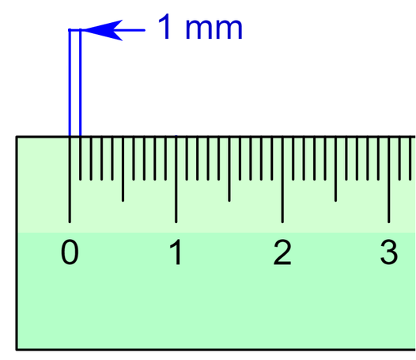
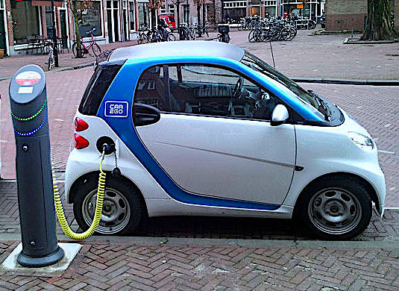
How do you measure electricity? 你怎样测试电？
Volts伏特 = amount of electric pressure
Amps电流 = amount of electric current
Watts瓦特 = volts X amps = total power
Milli = 1 thousandth
Example: 3 volts X 2 milliamps = 6 milliwatts

Slide 3
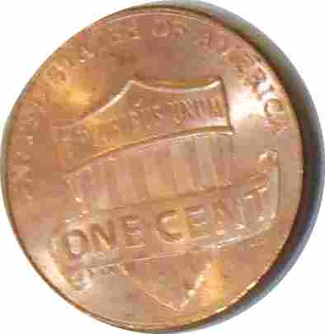
What do you need for a lemon battery?
a copper strip
a zinc strip
and a slice of lemon
一片柠檬
or a penny
or a galvanized nail

Slide 4
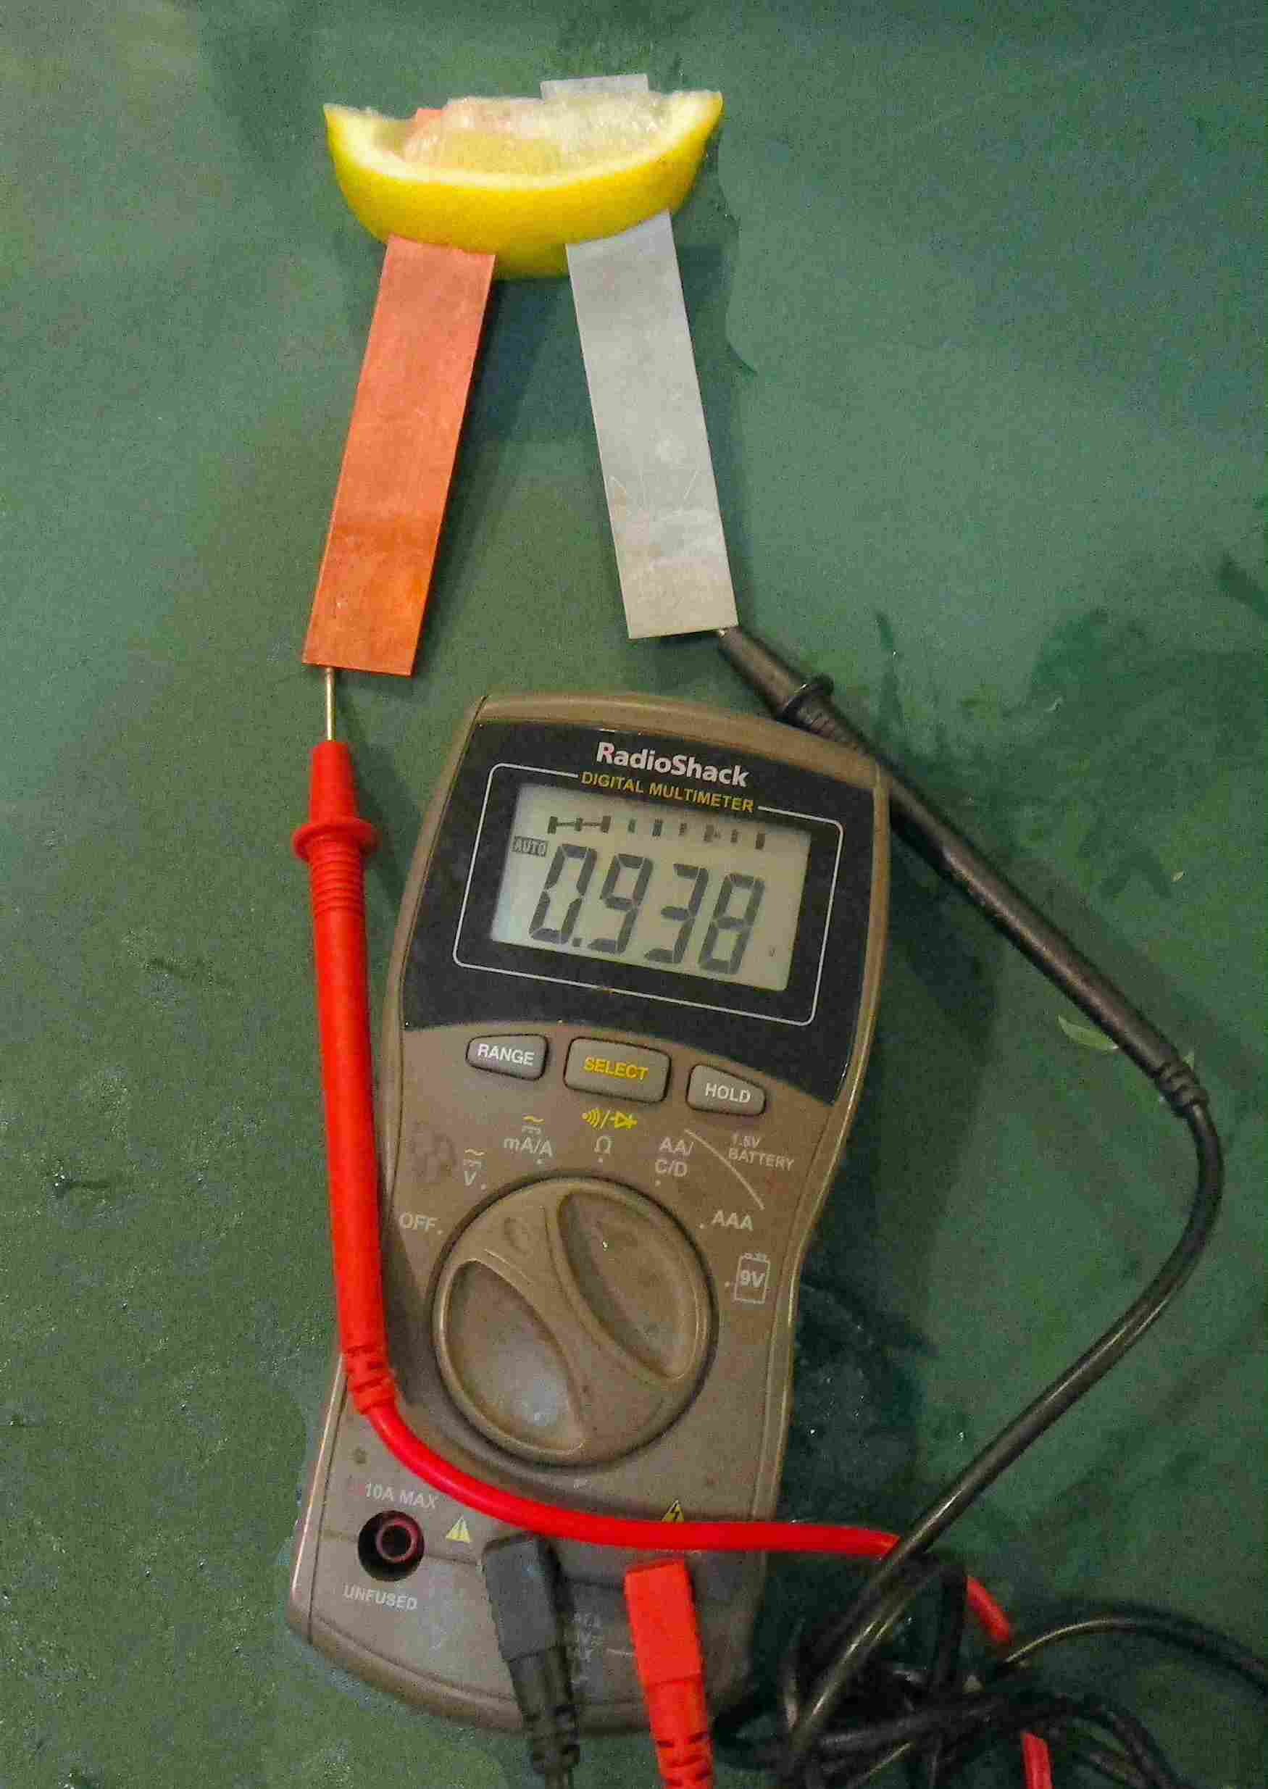
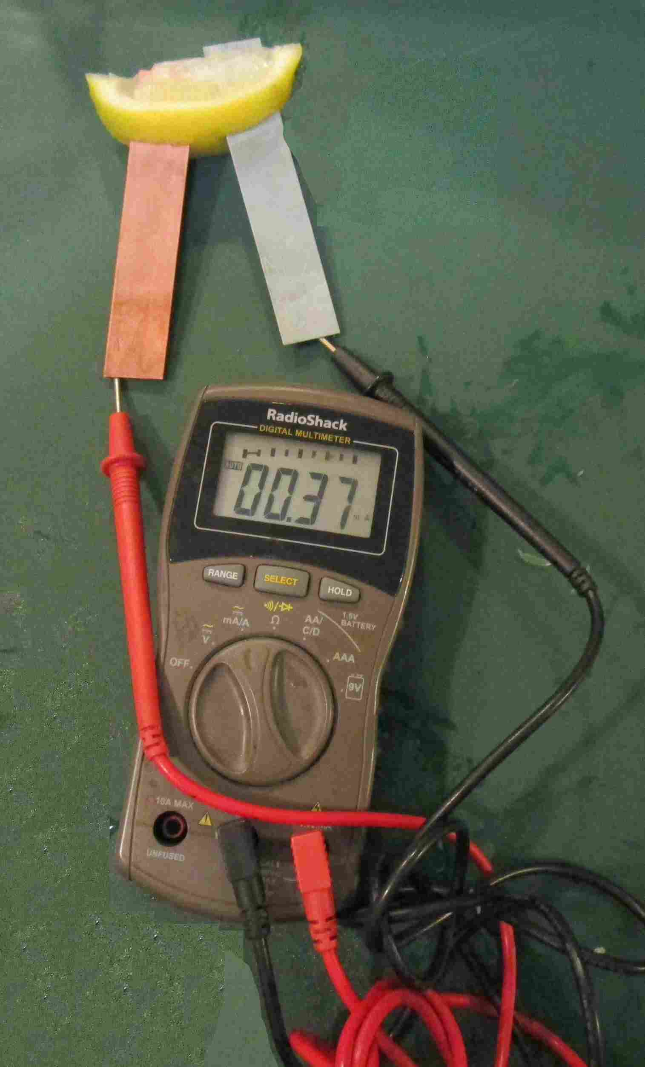
How many volts and milliamps are generated by 1 lemon battery 一个柠檬电池?
0.938 volts
0.37 milliamps

Slide 5
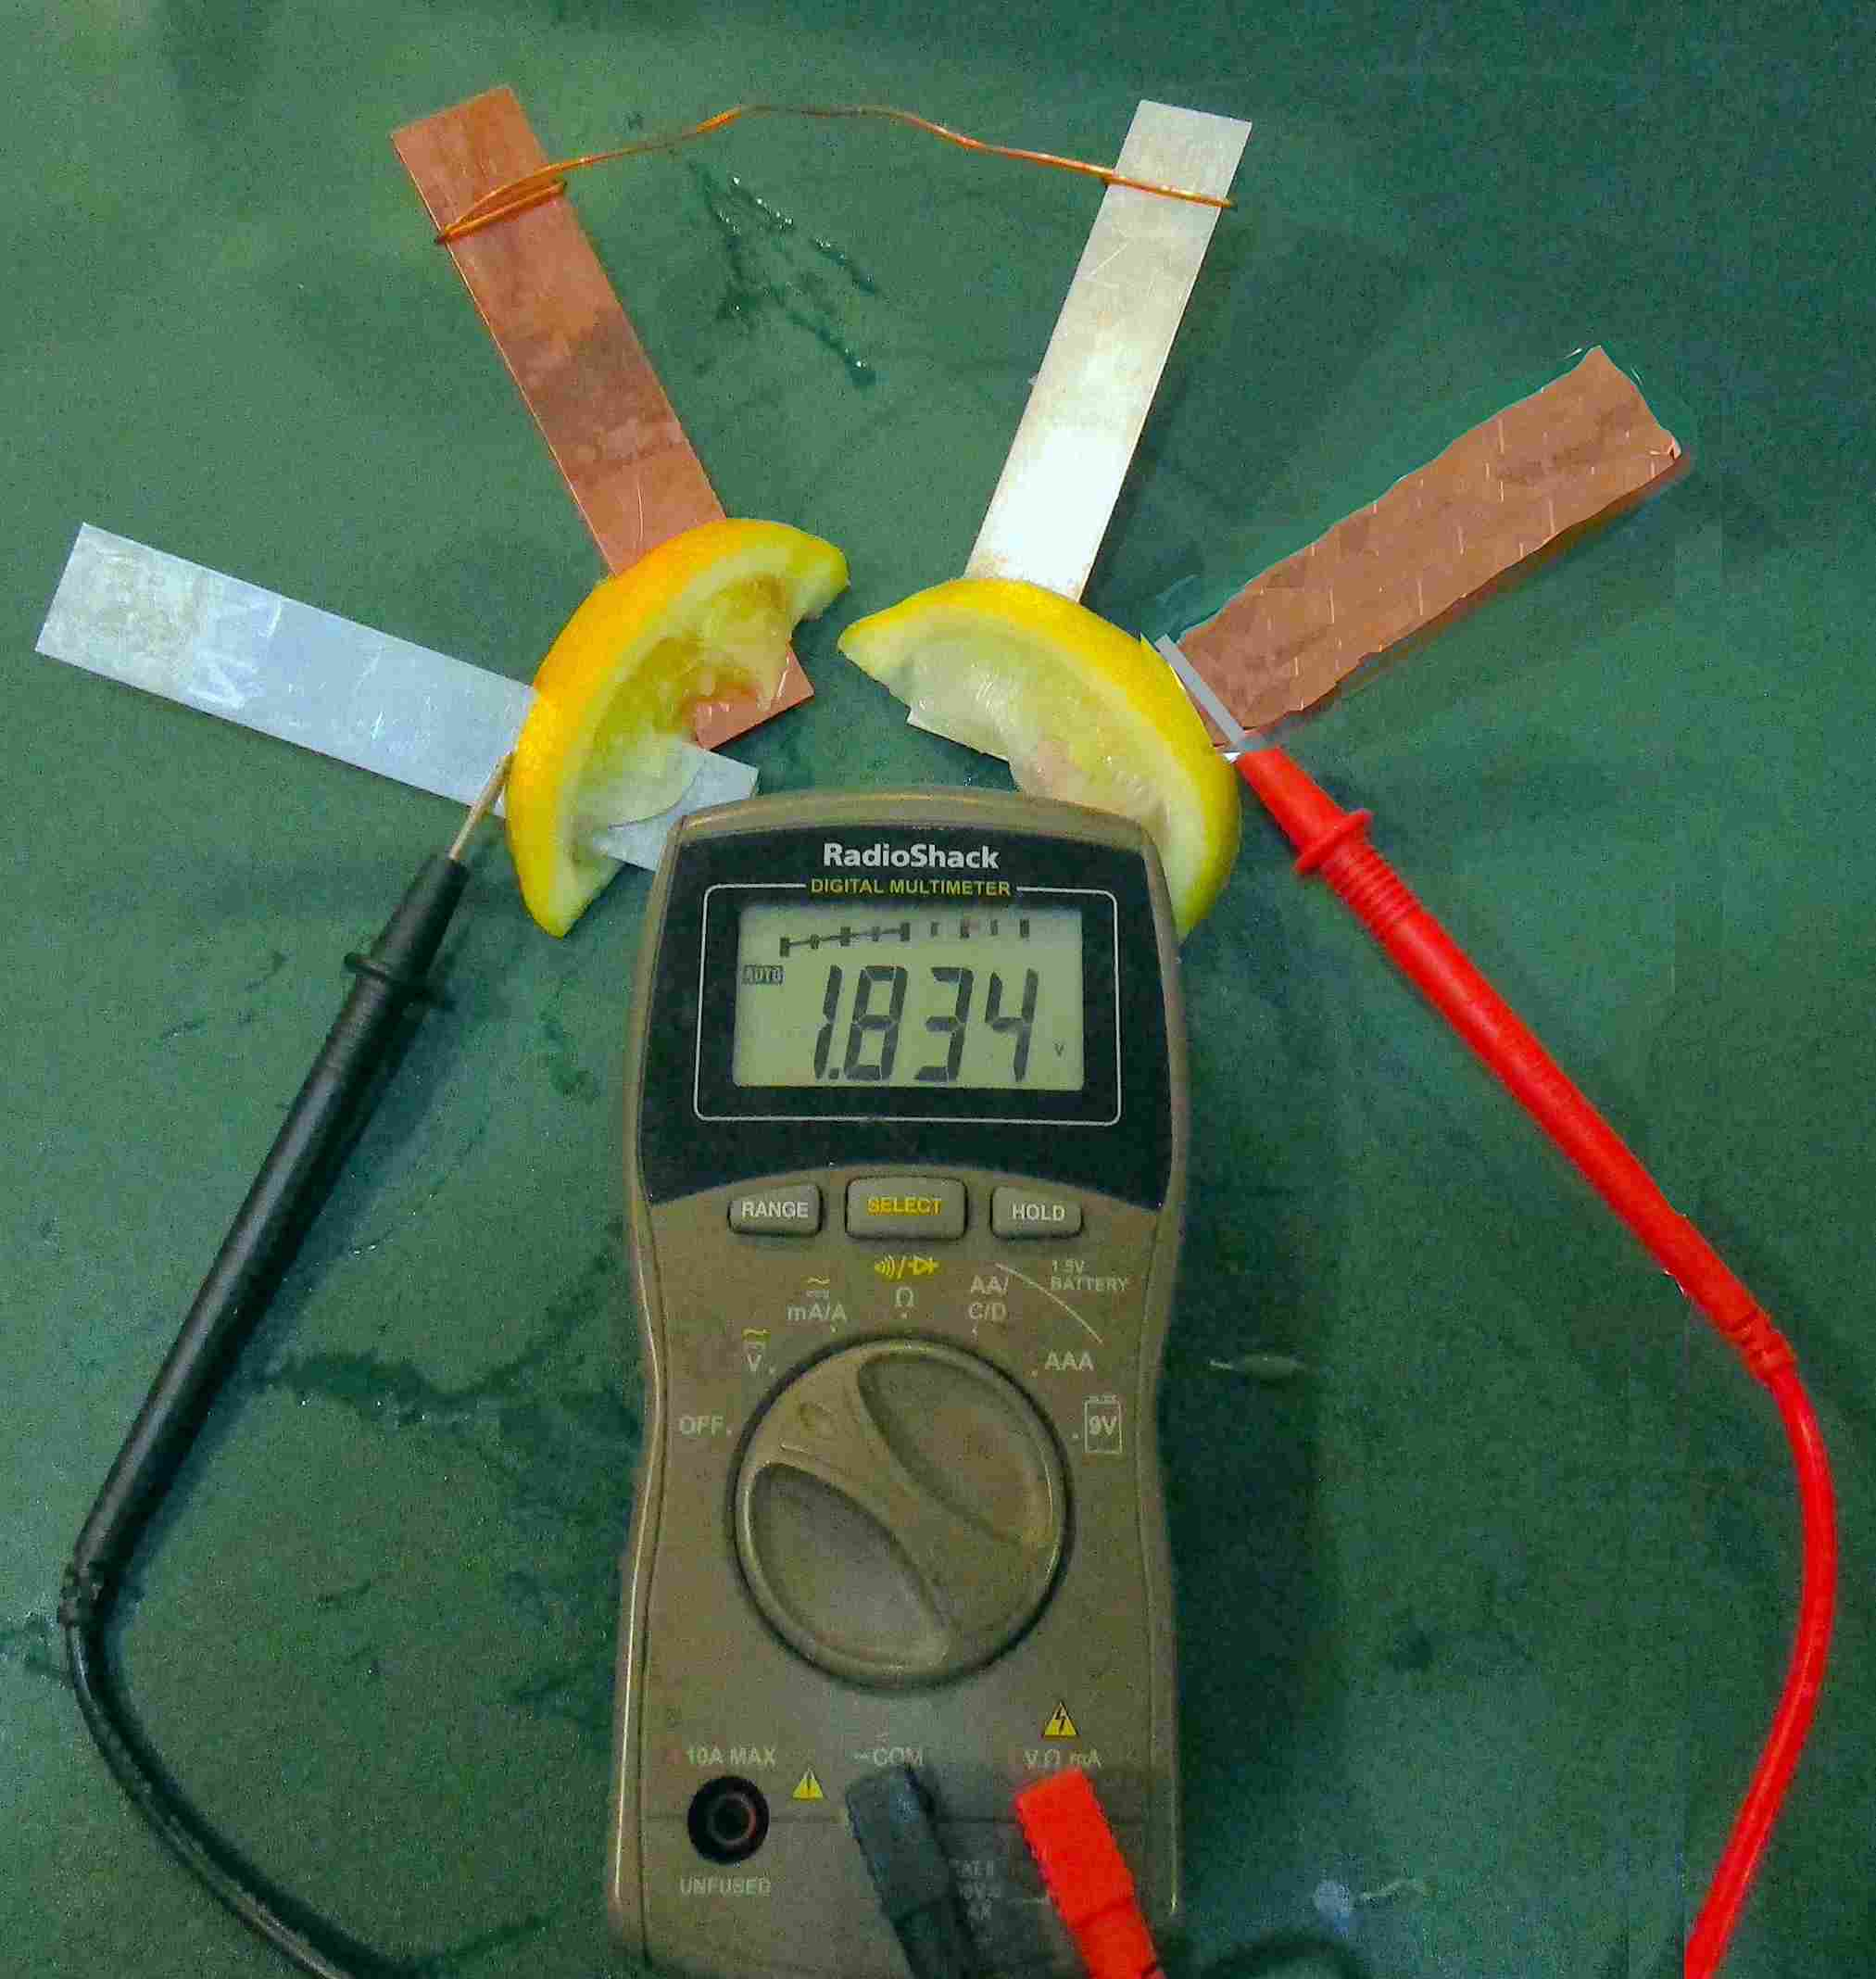
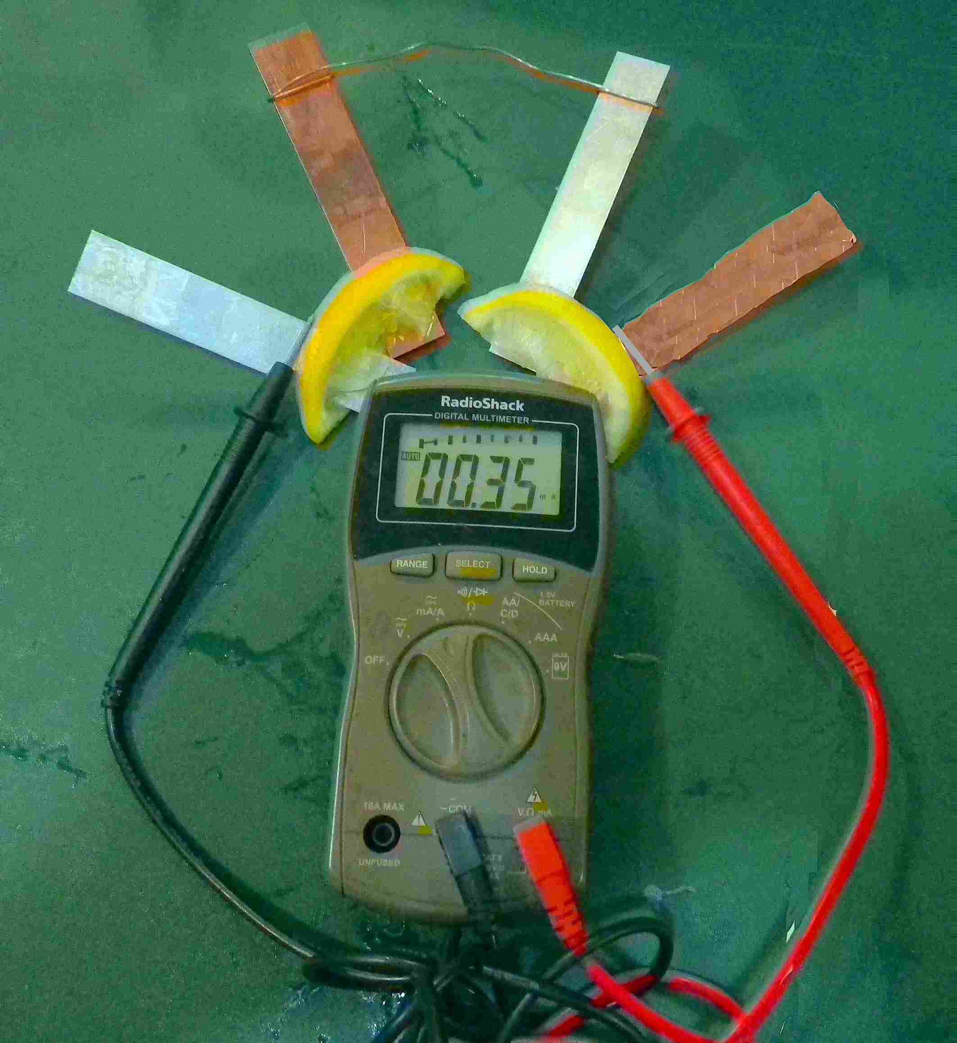
How many volts and milliamps are generated by 2 lemon batteries 两个柠檬电池 ?

Slide 6
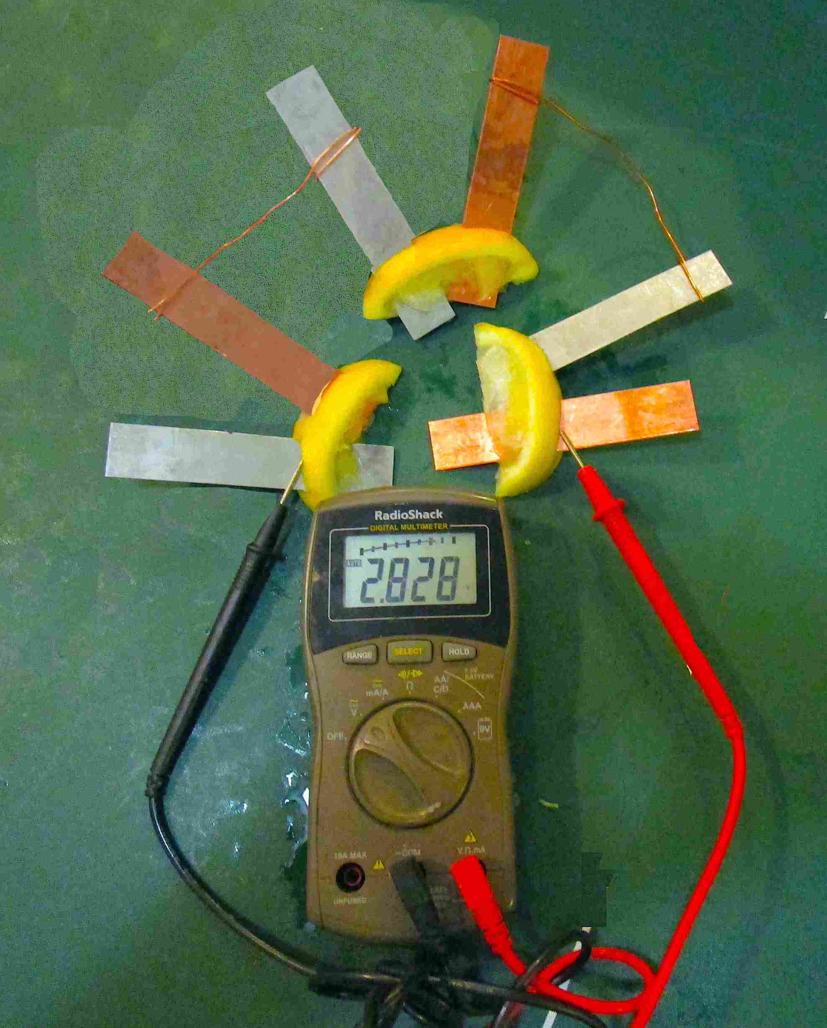
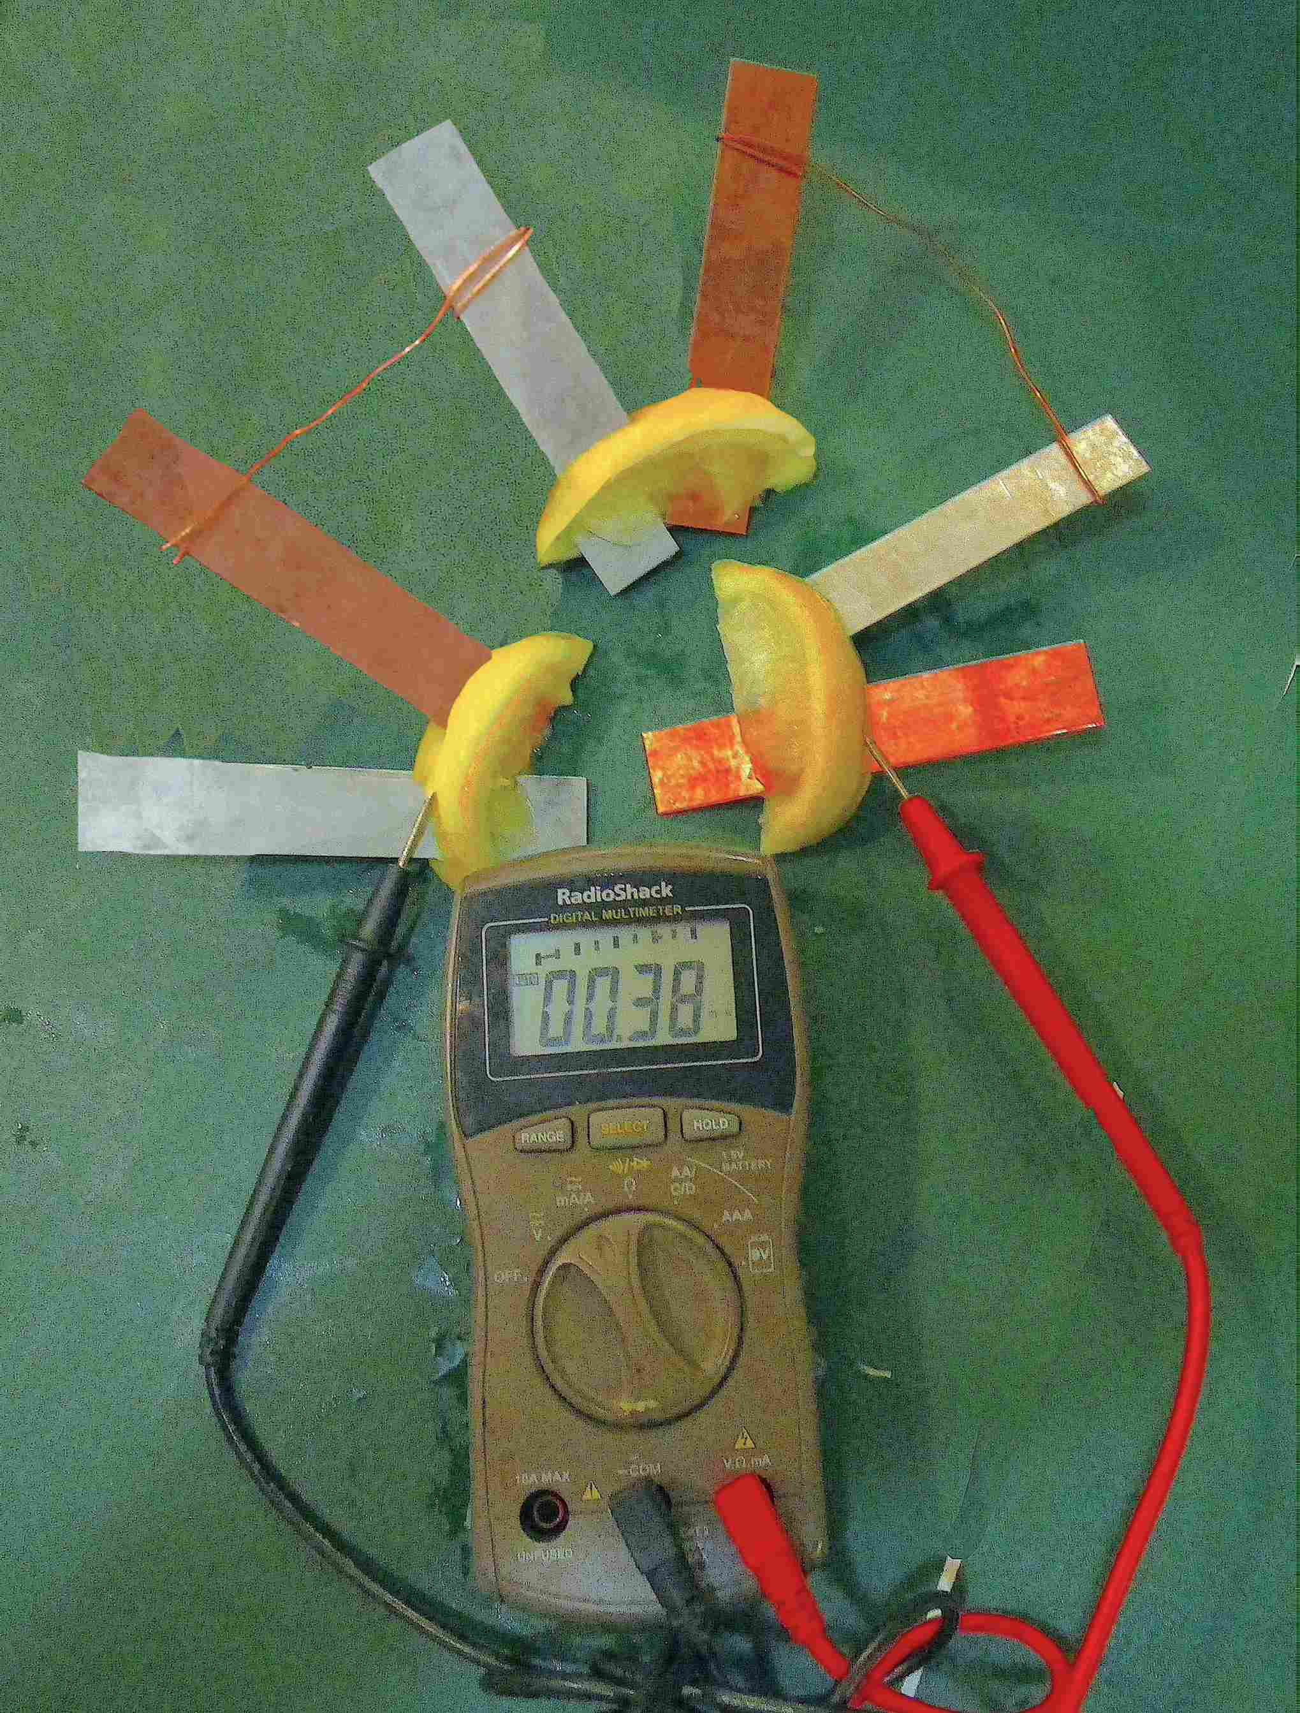
How many volts and milliamps are generated by 3 lemon batteries 三个柠檬电池 ?

Slide 7
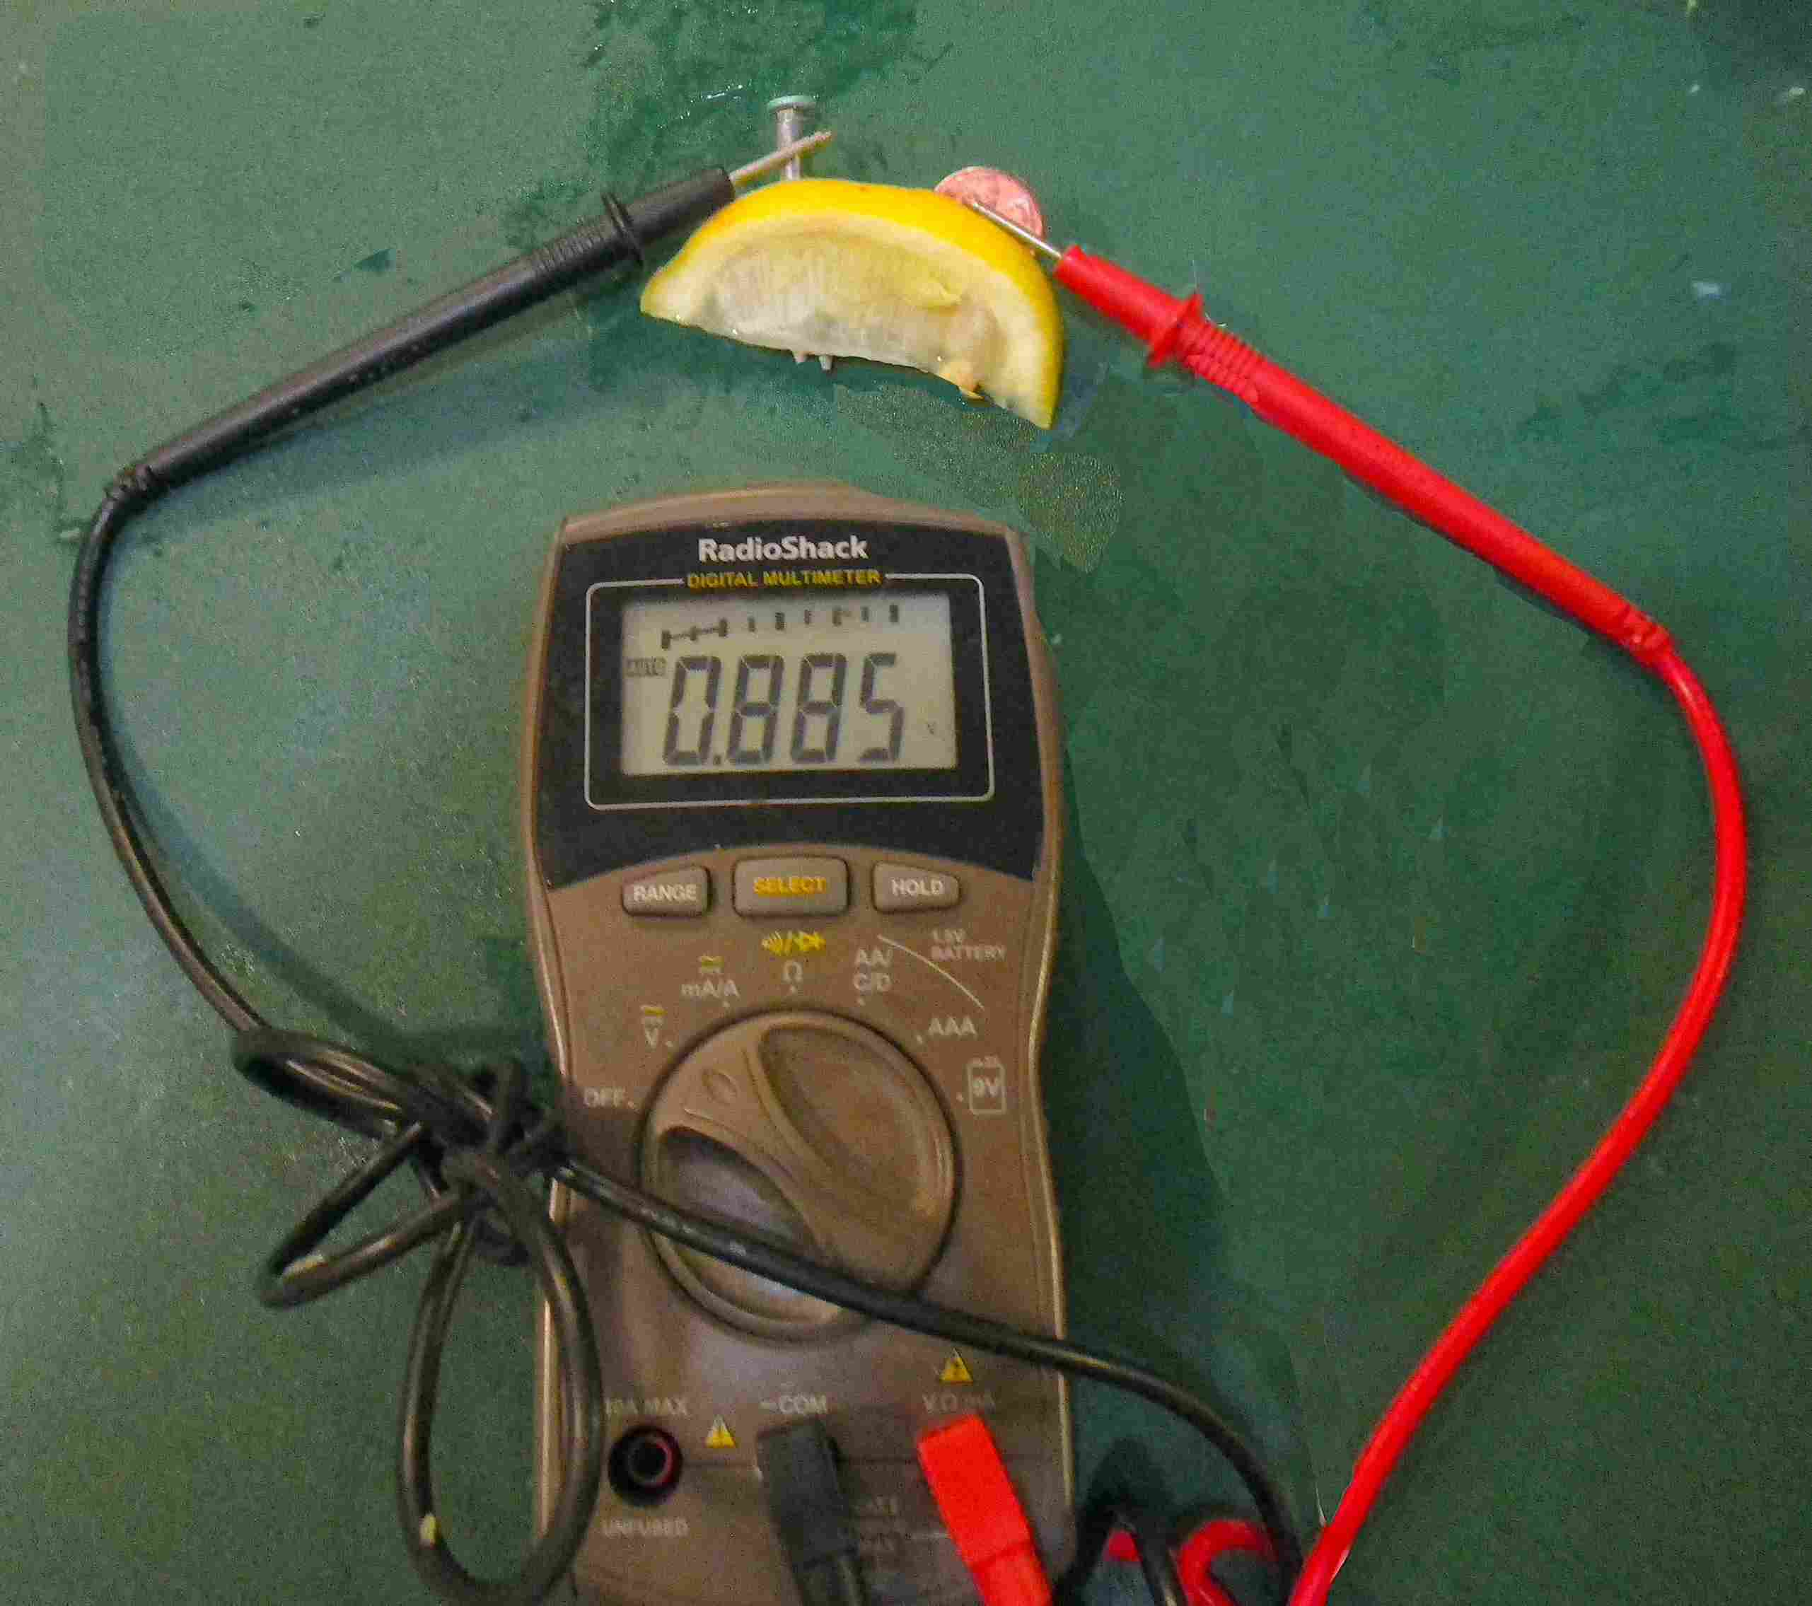
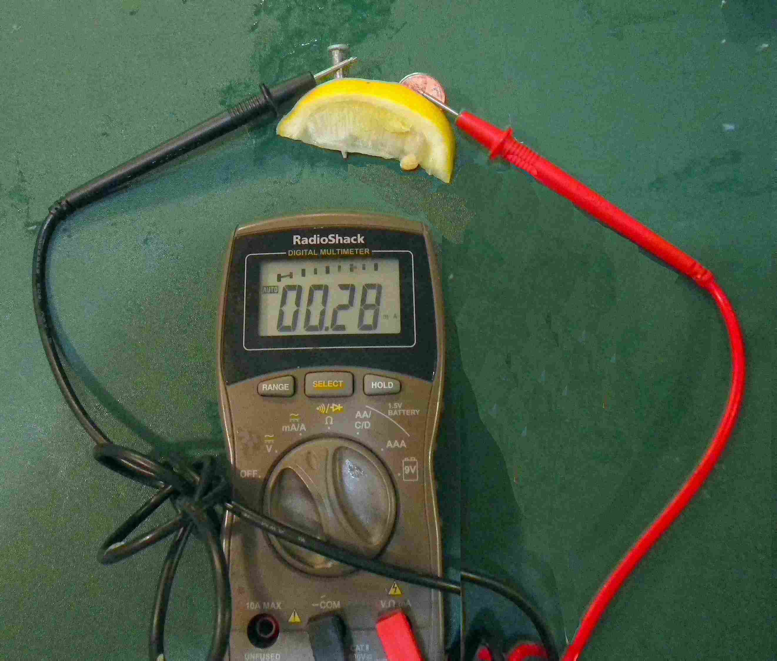
How many volts and milliamps are generated by 1 lemon (一个柠檬) with a nail & penny?

Slide 8
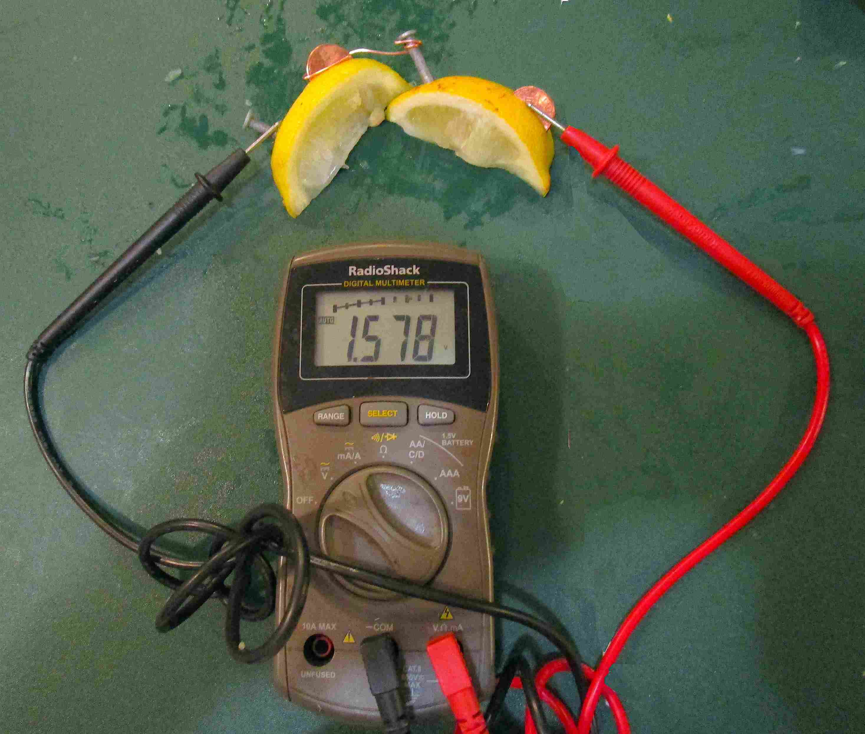
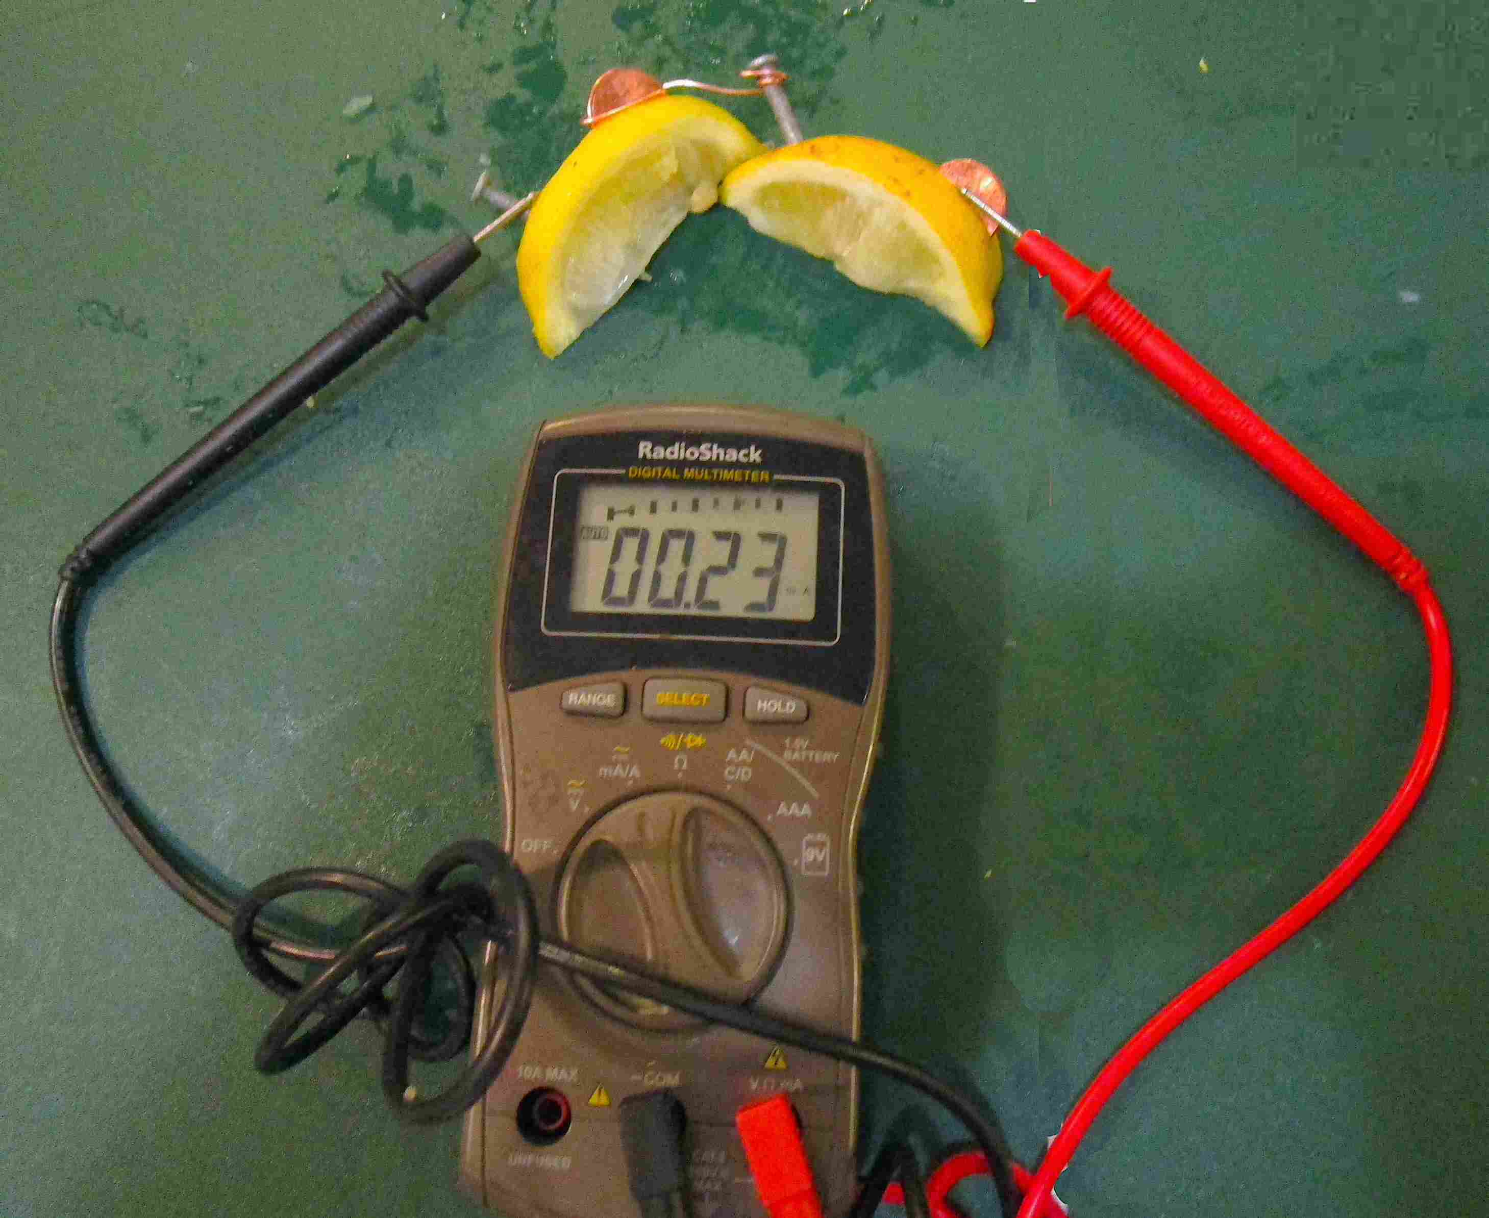
How many volts and milliamps are generated by 2 lemons(两个柠檬)with nails & pennies?

Slide 9
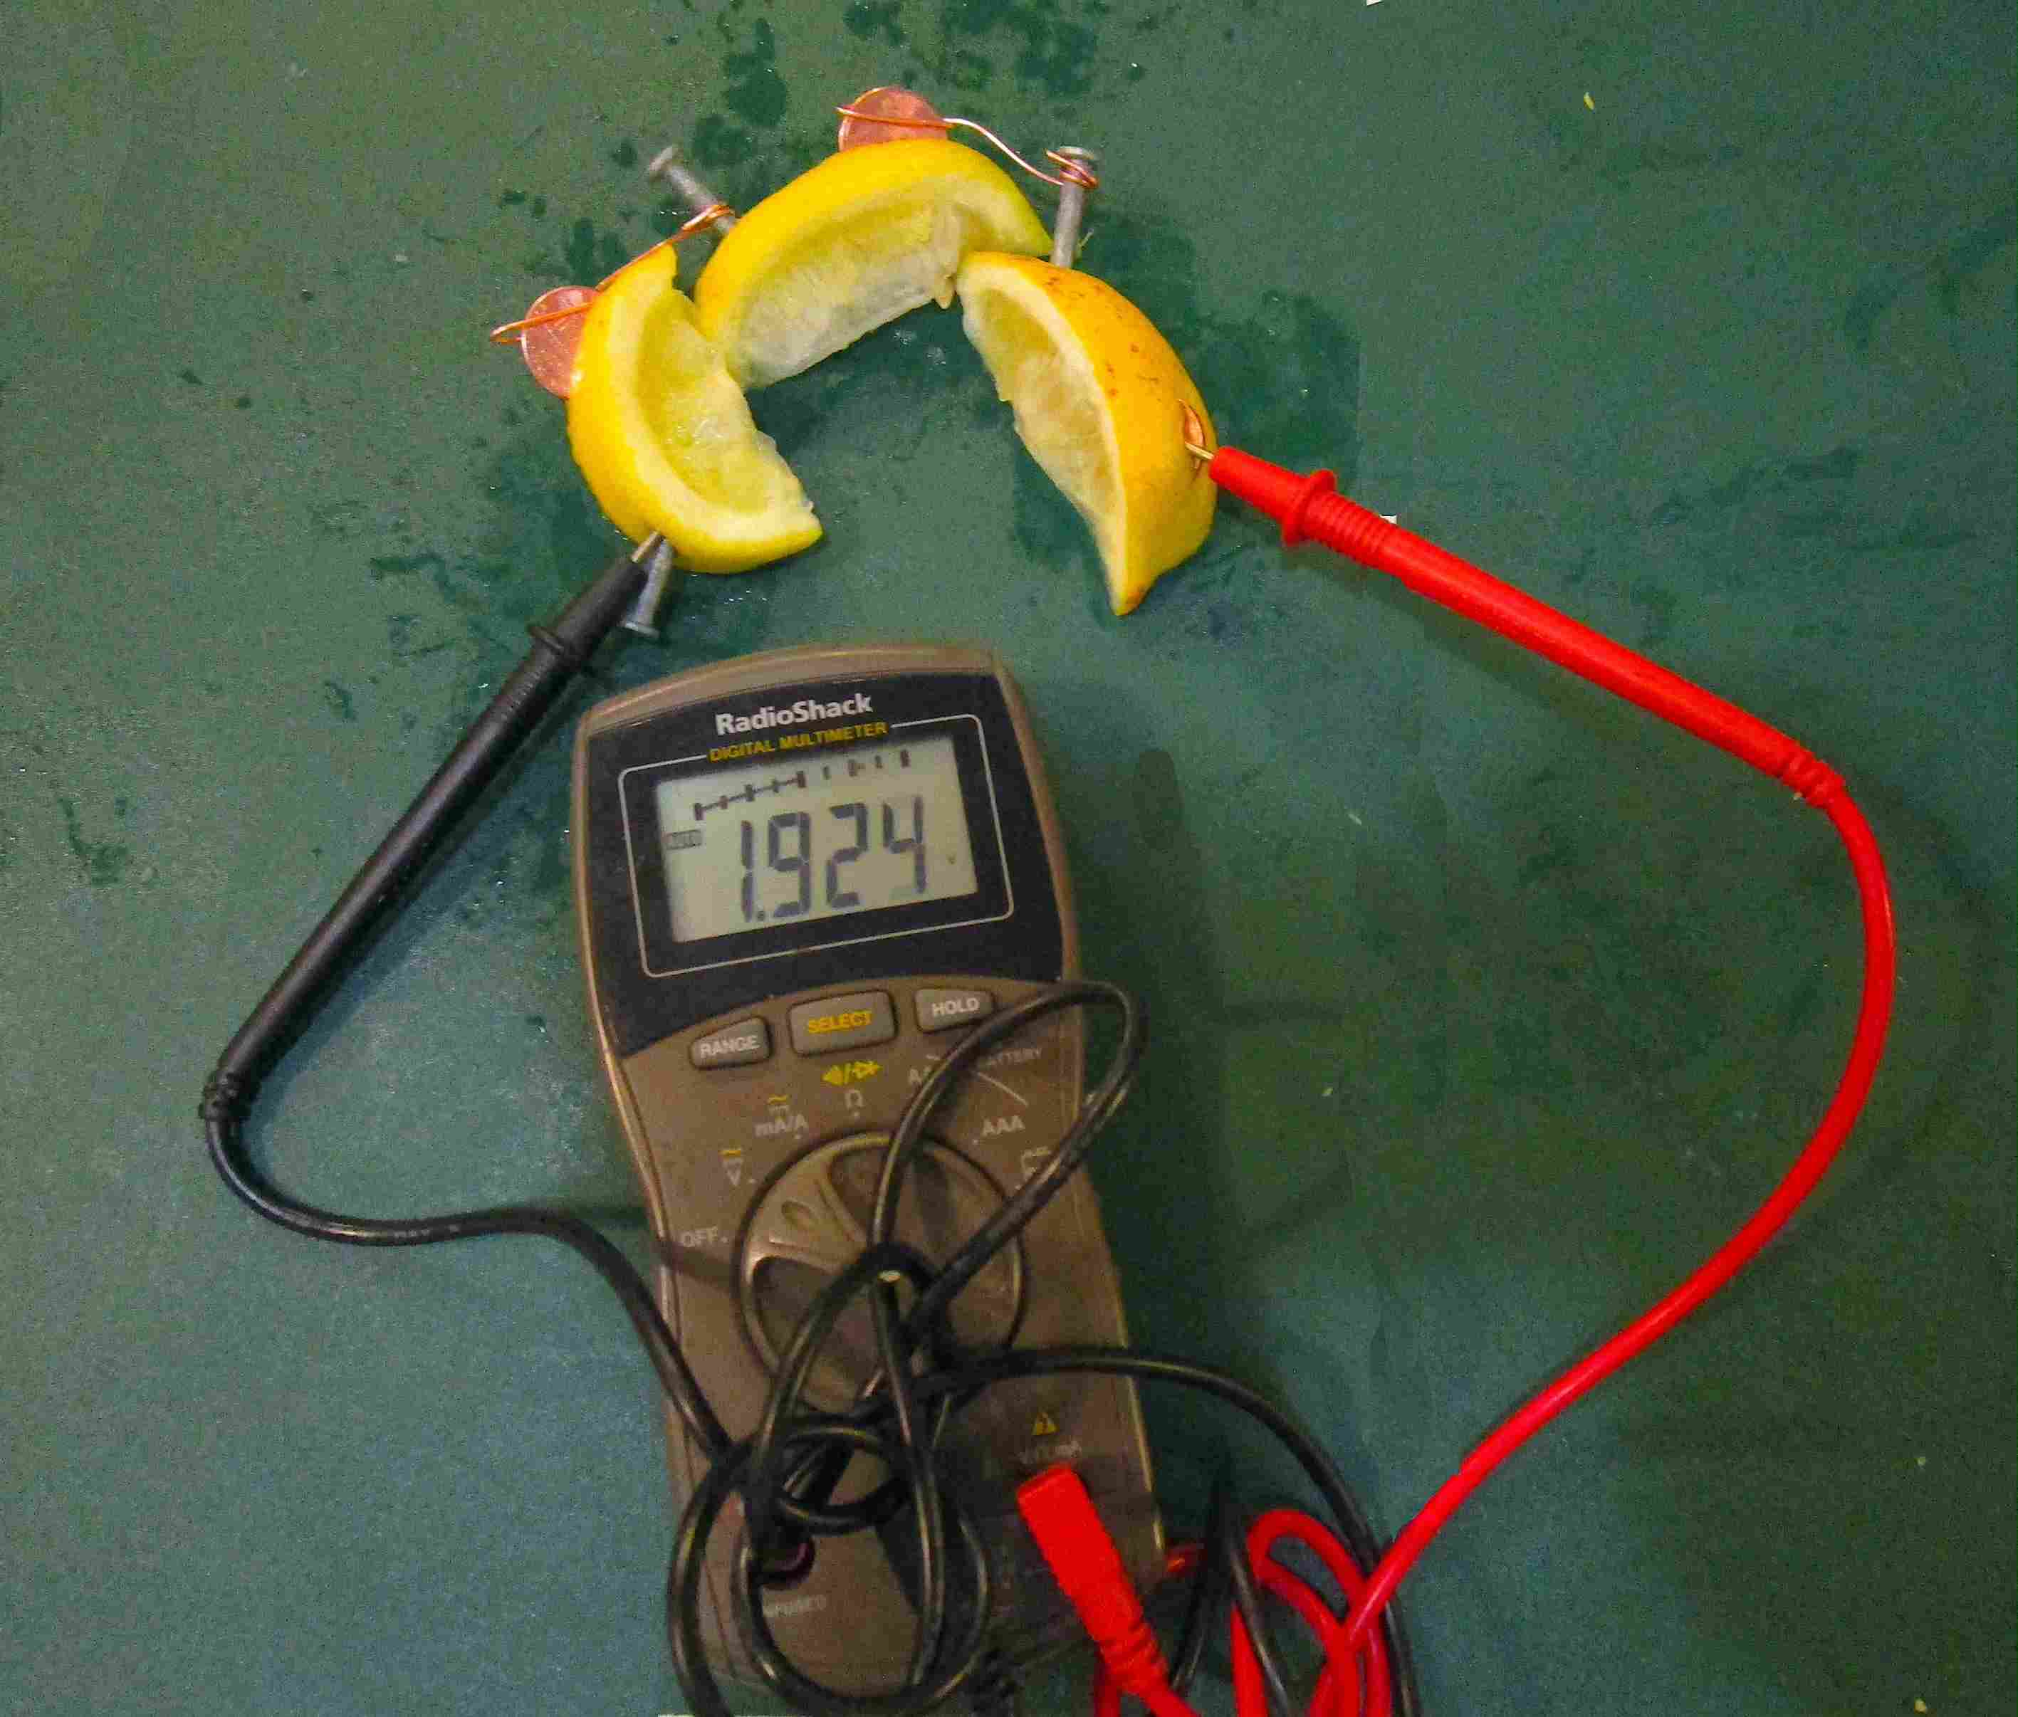
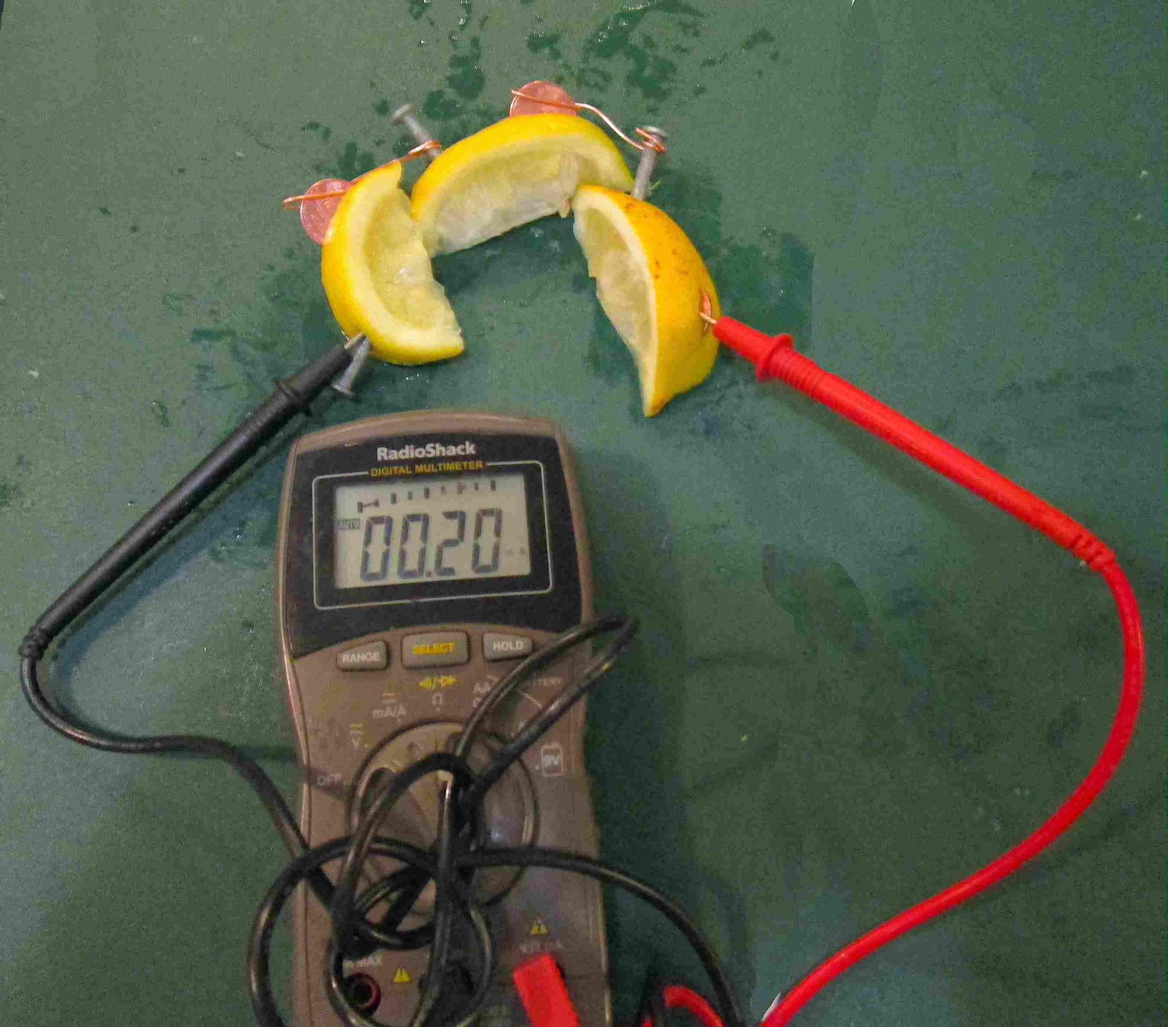
How many volts and milliamps are generated by 3 lemons(三个柠檬) with nails & pennies?

Slide 10
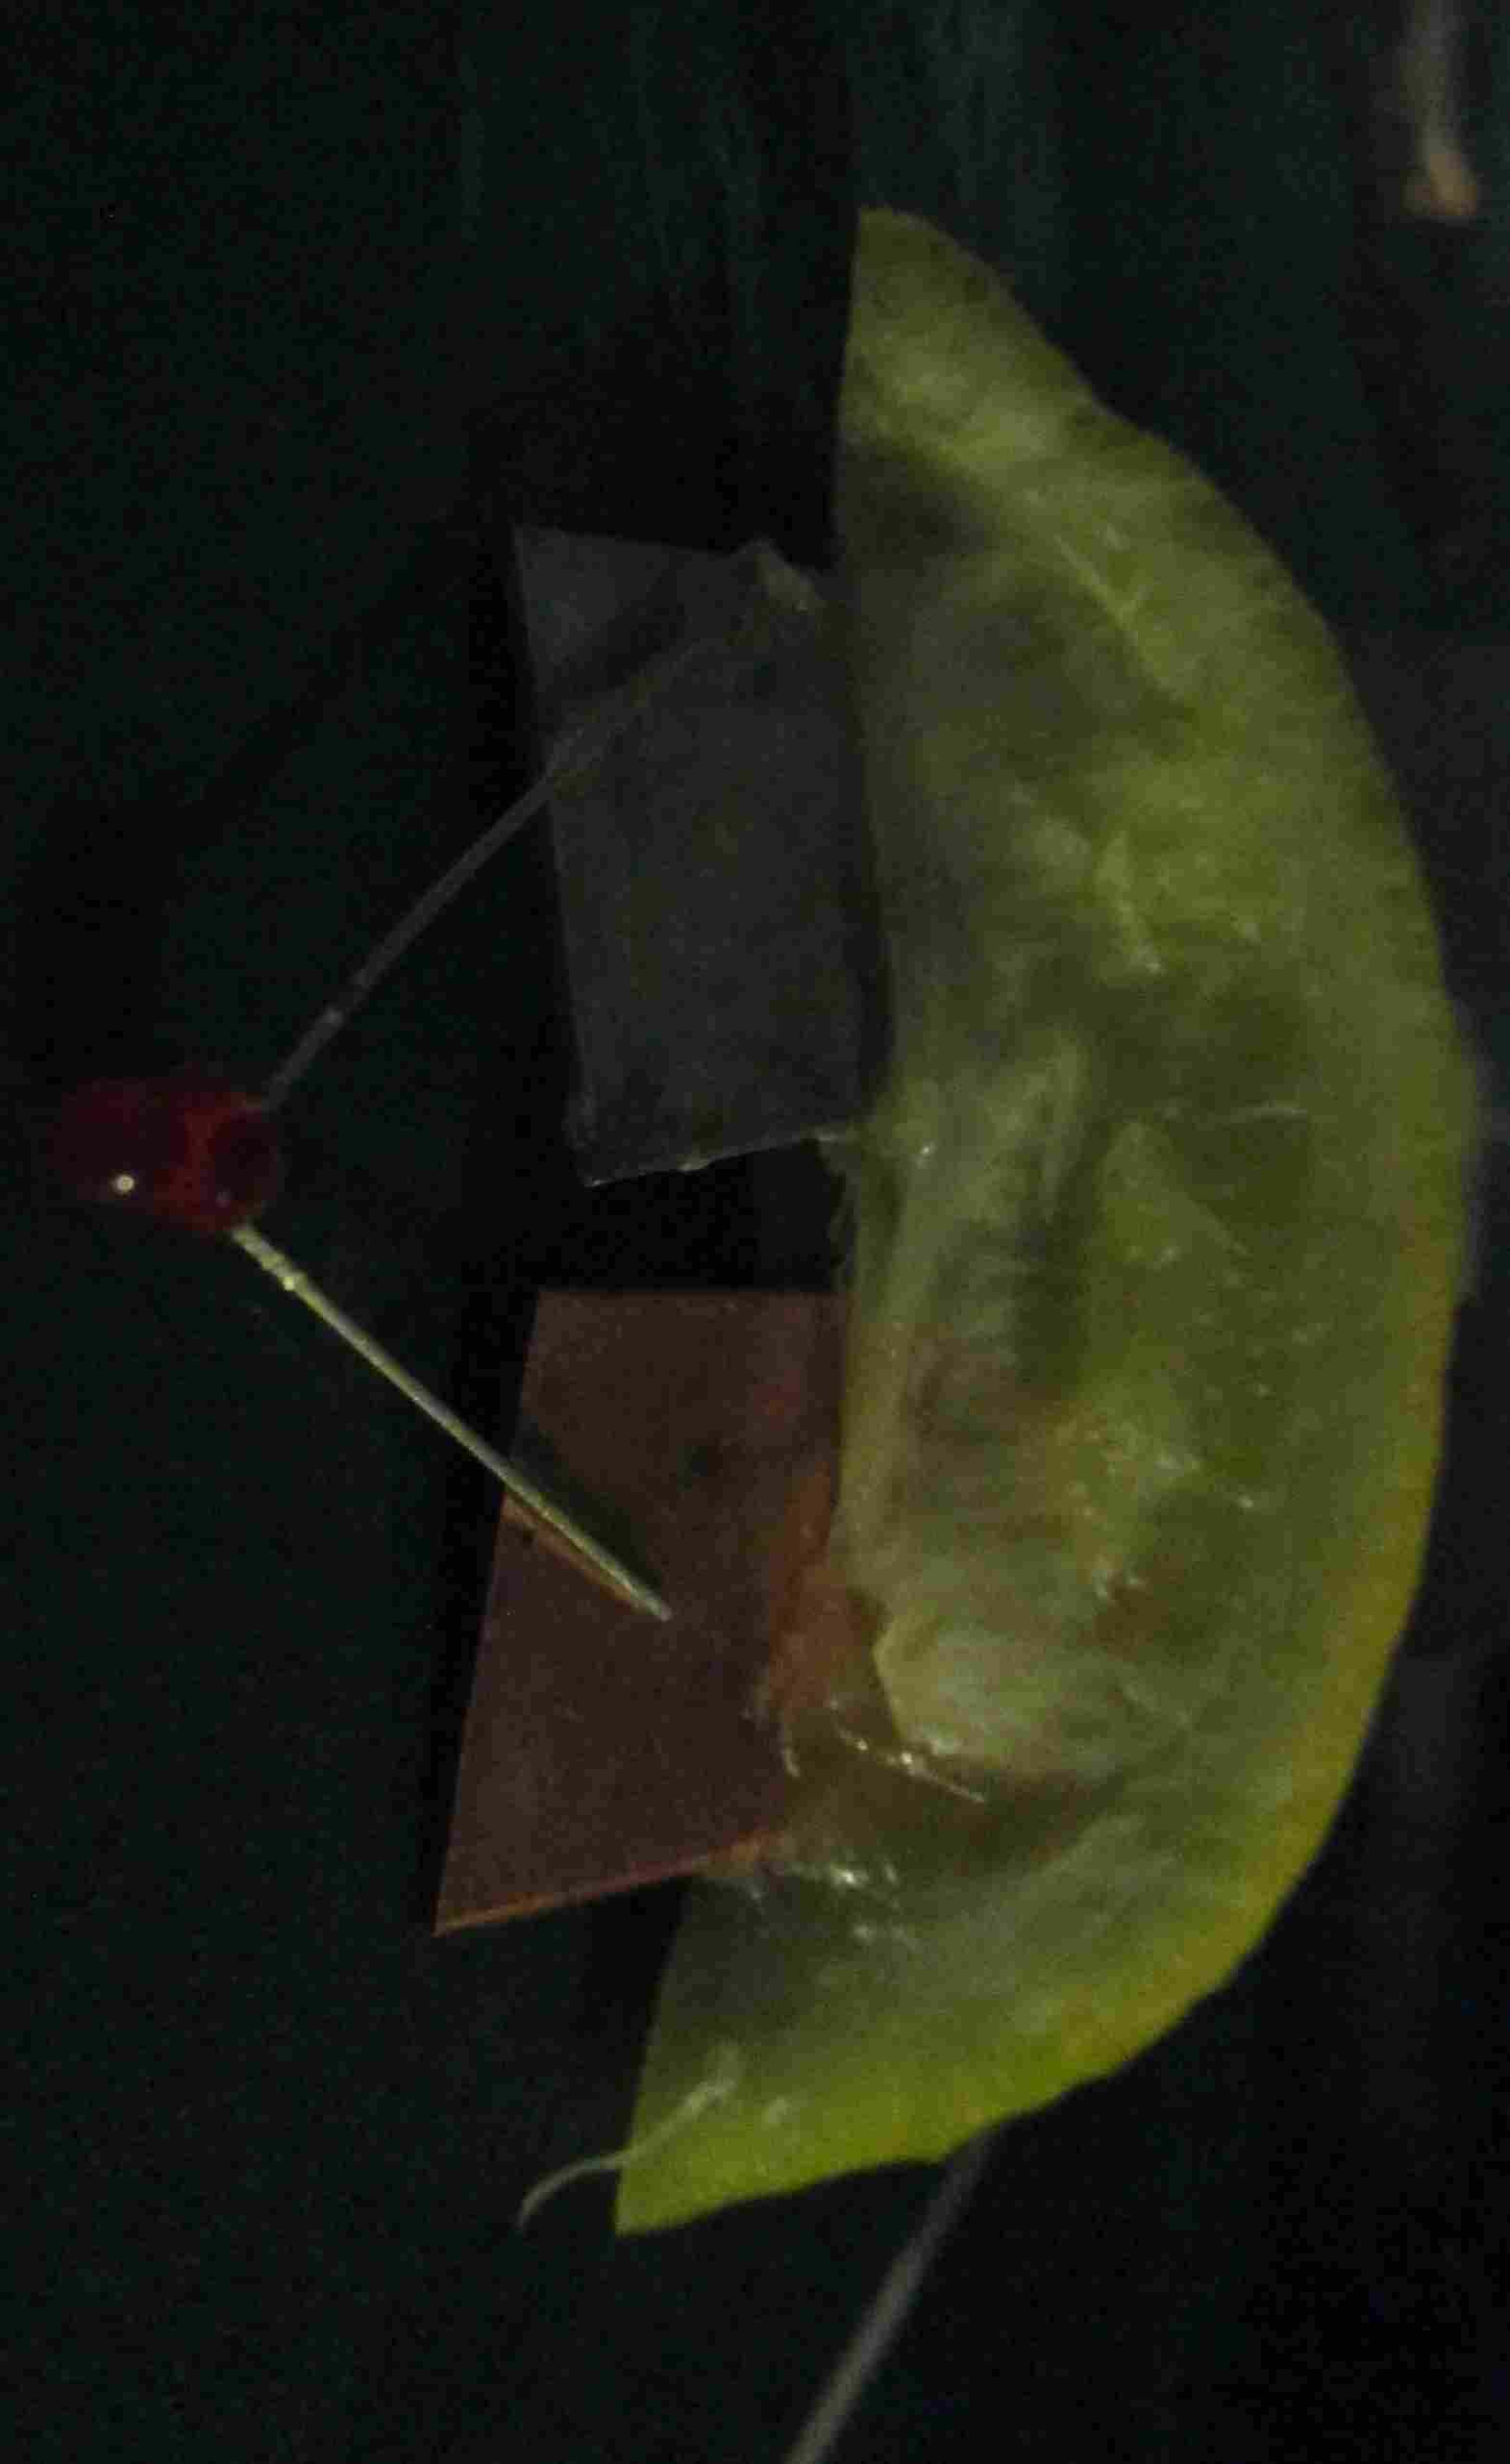
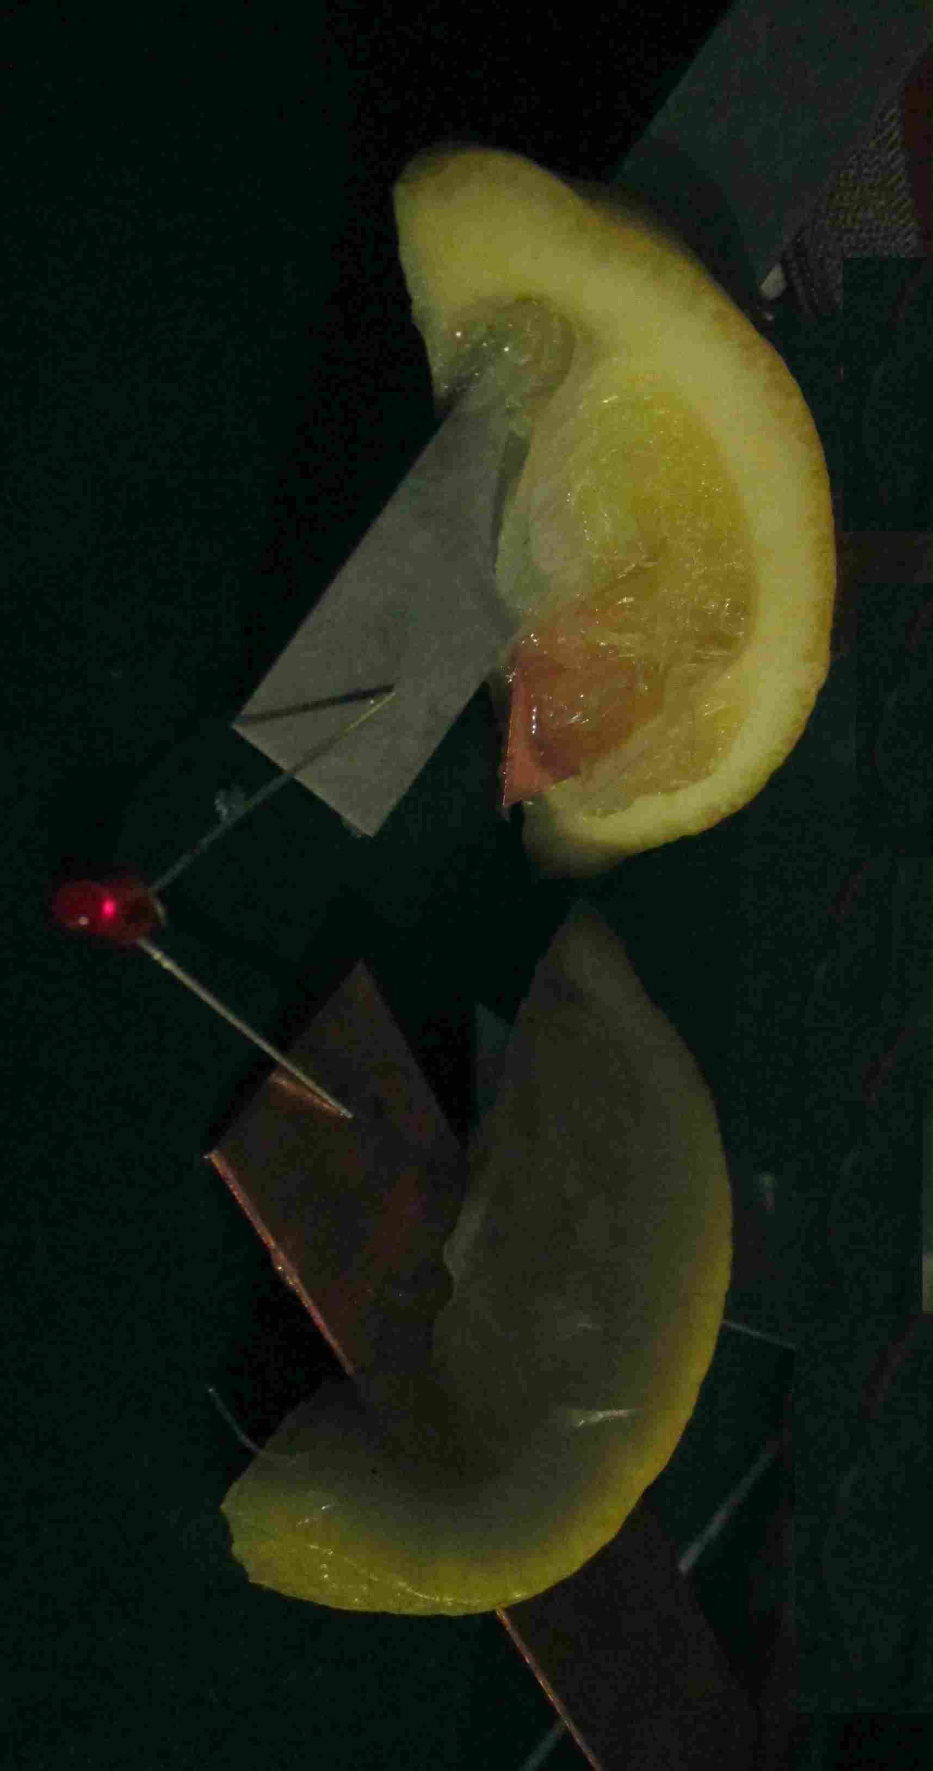
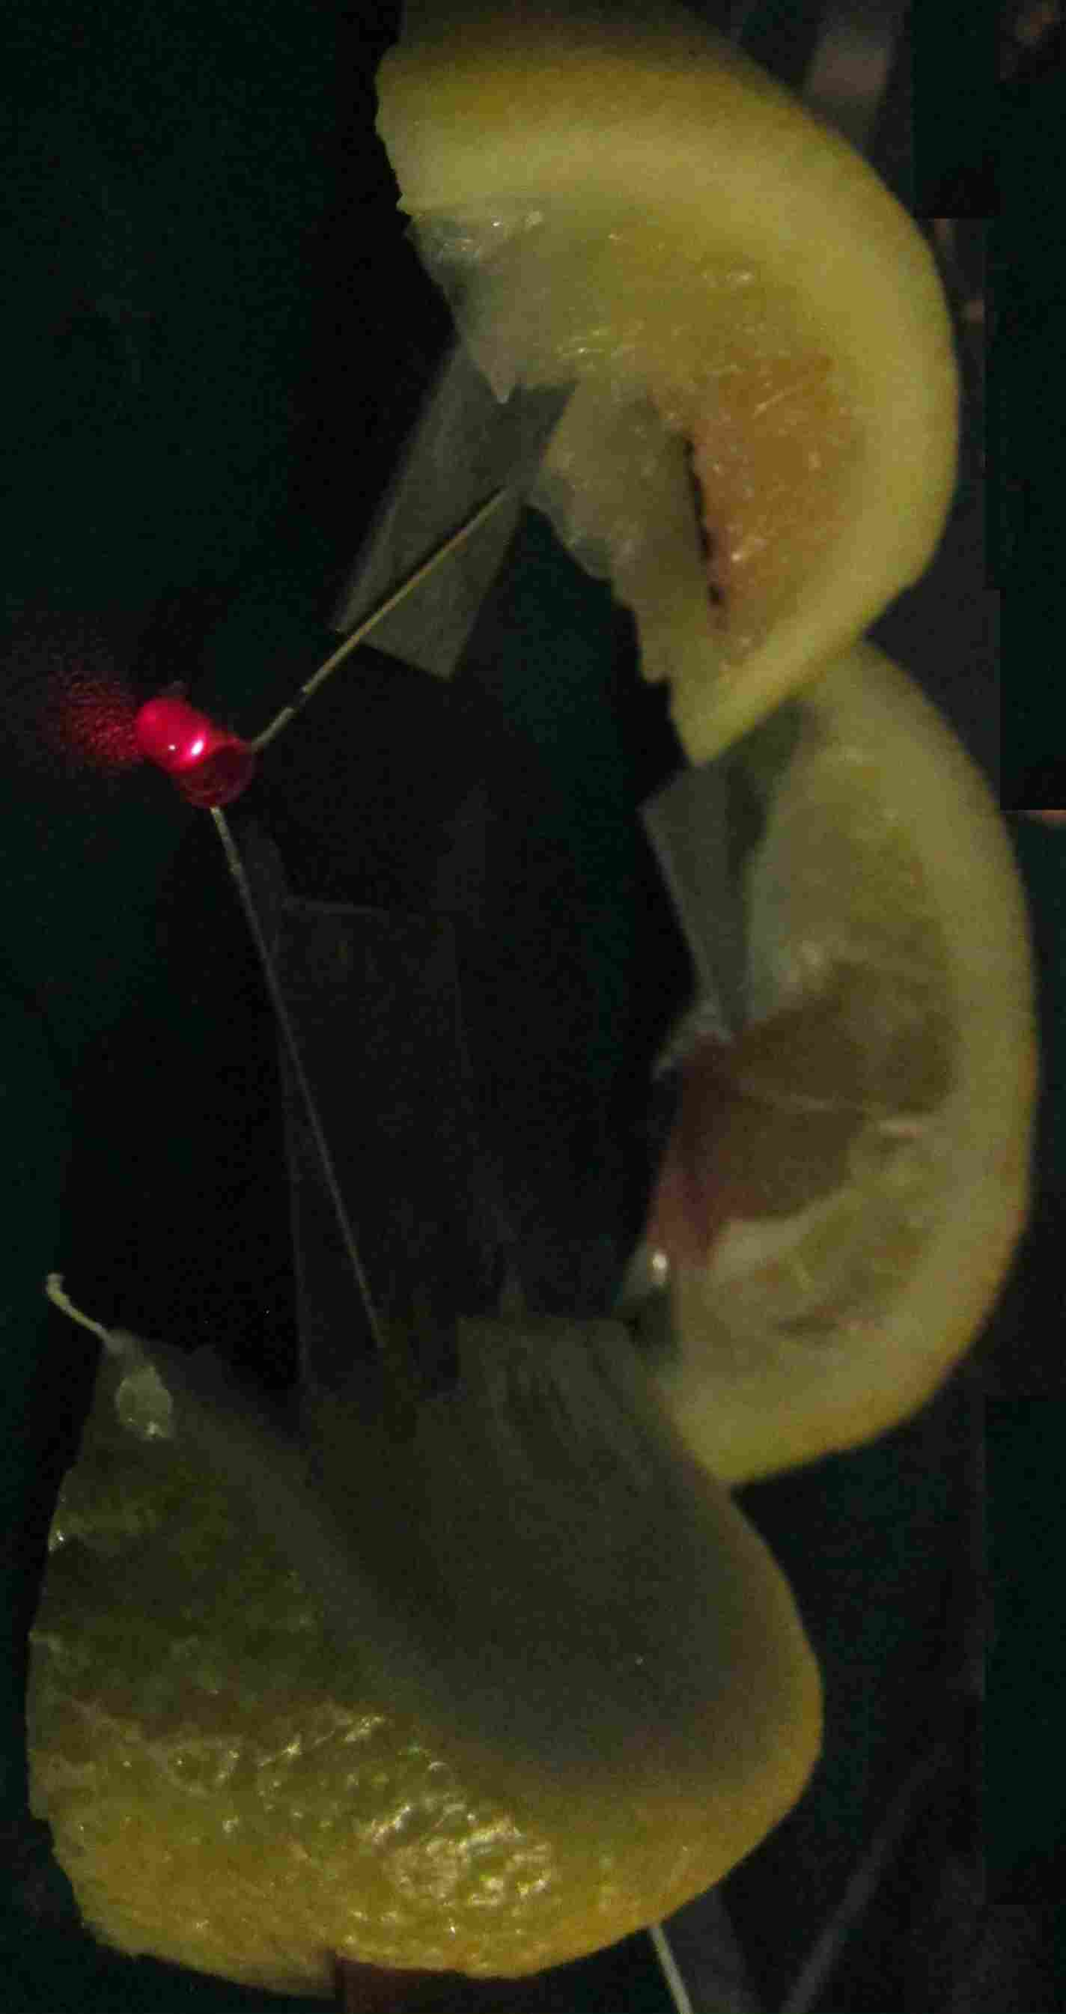
How many lemons with metal strips do you need to light up an LED?
1 battery 一
2 batteries二
3 batteries 三个电池

Slide 11
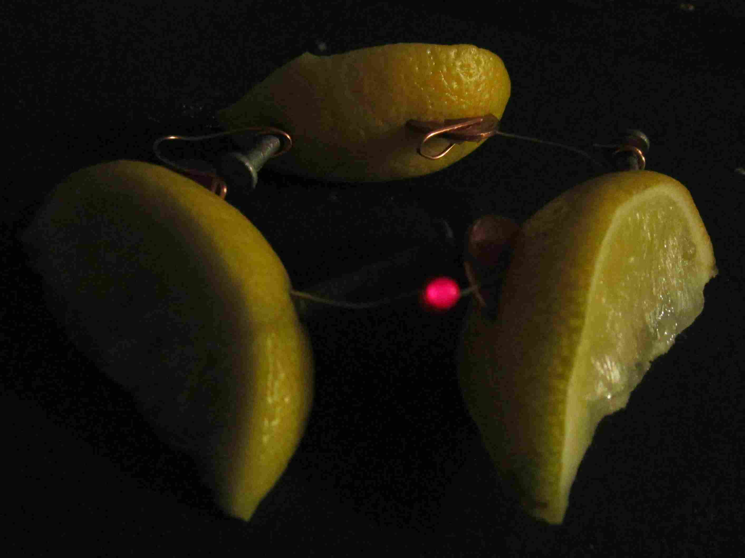
How many lemons with nails & pennies do you need to light up an LED?
3 batteries

Slide 12
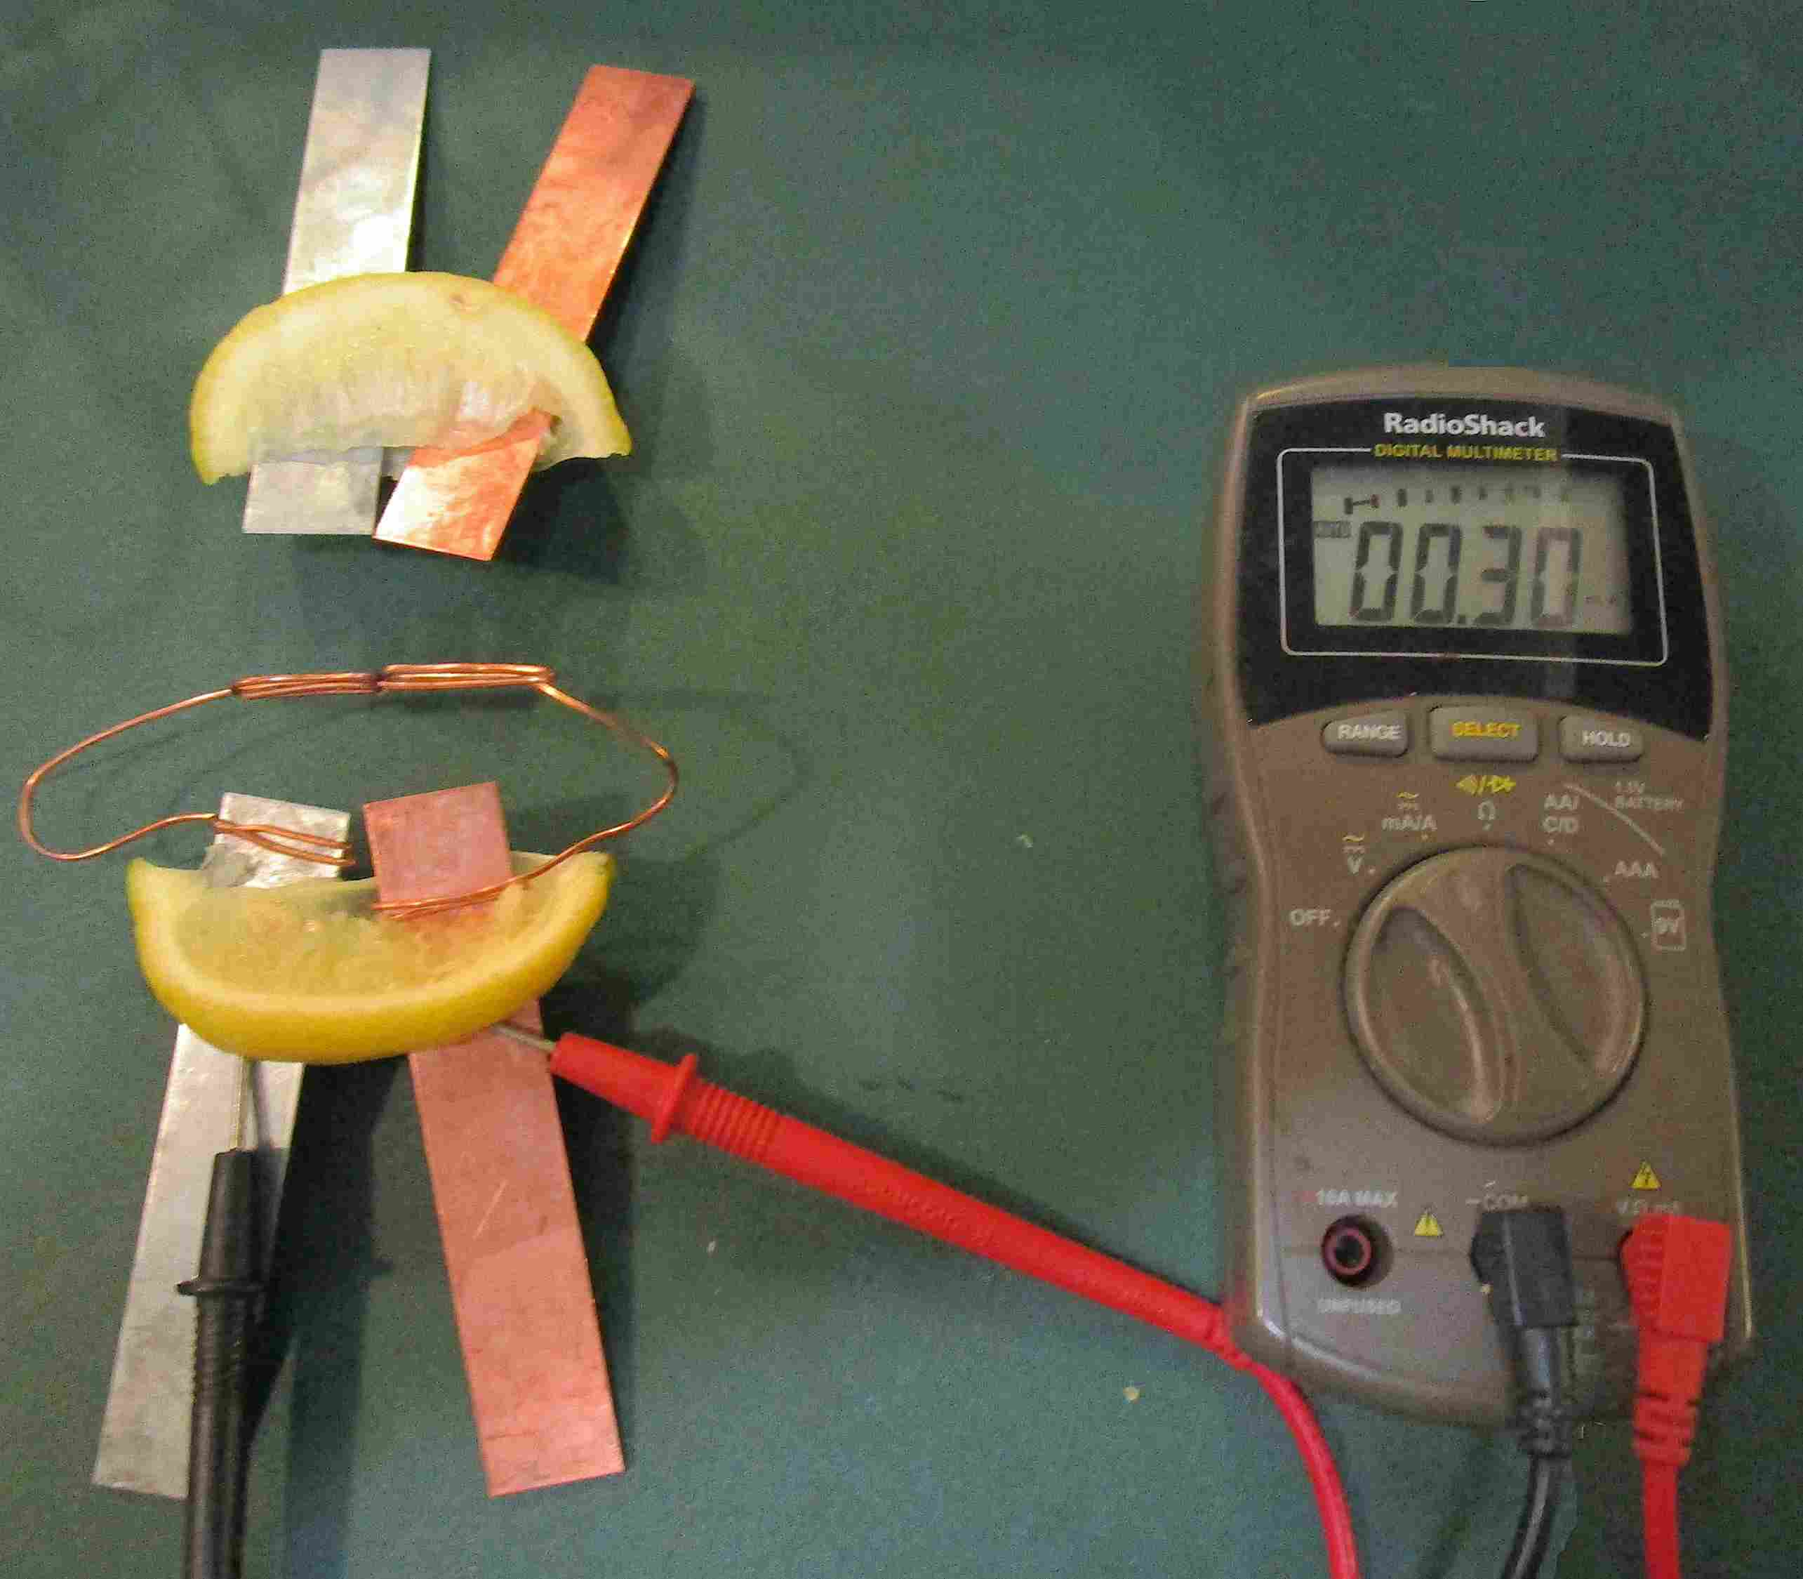
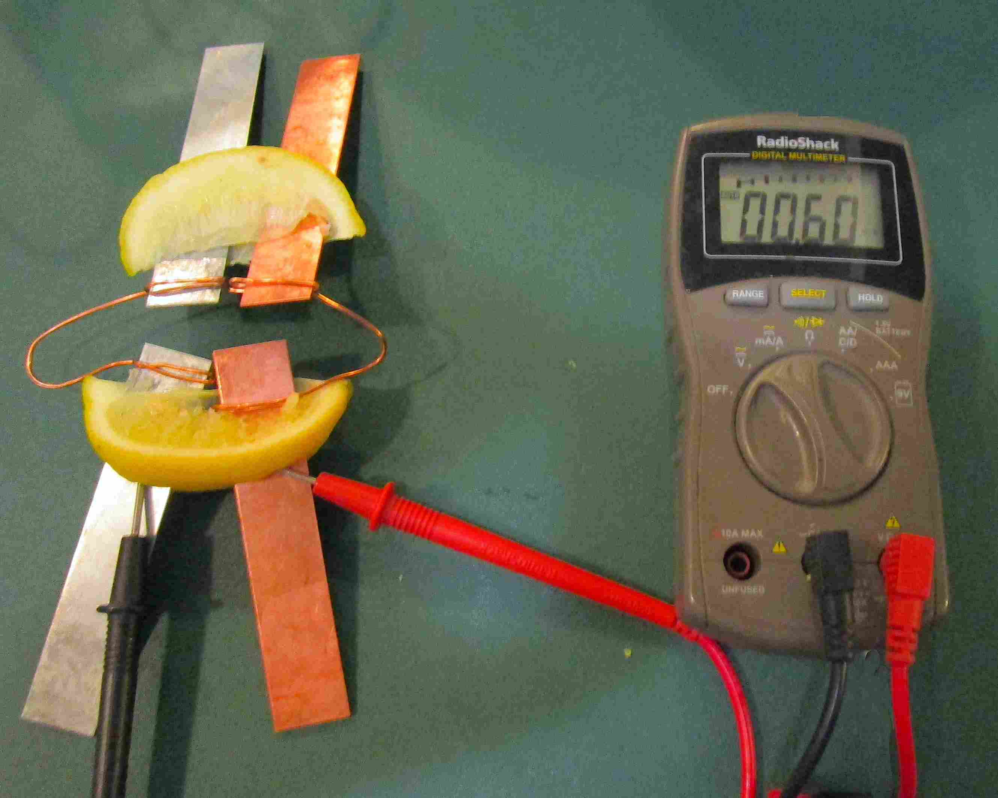
What happens to amperage when you connect the batteries parallel to each other?
1 battery 一个电池
2 batteries 两个电池

Slide 13
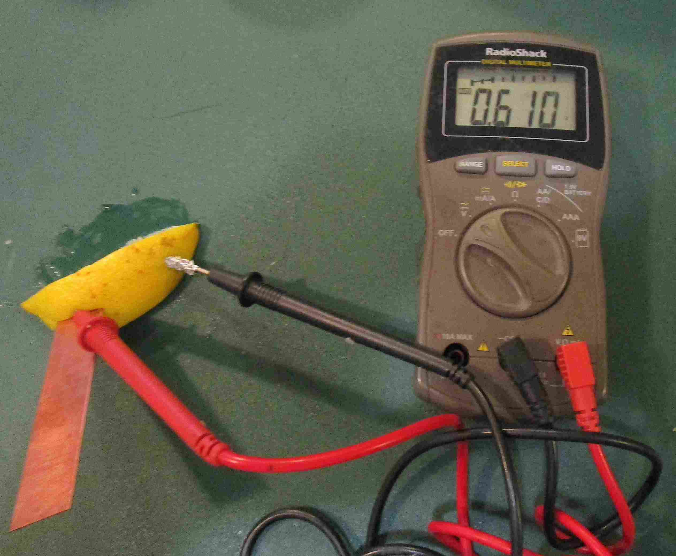
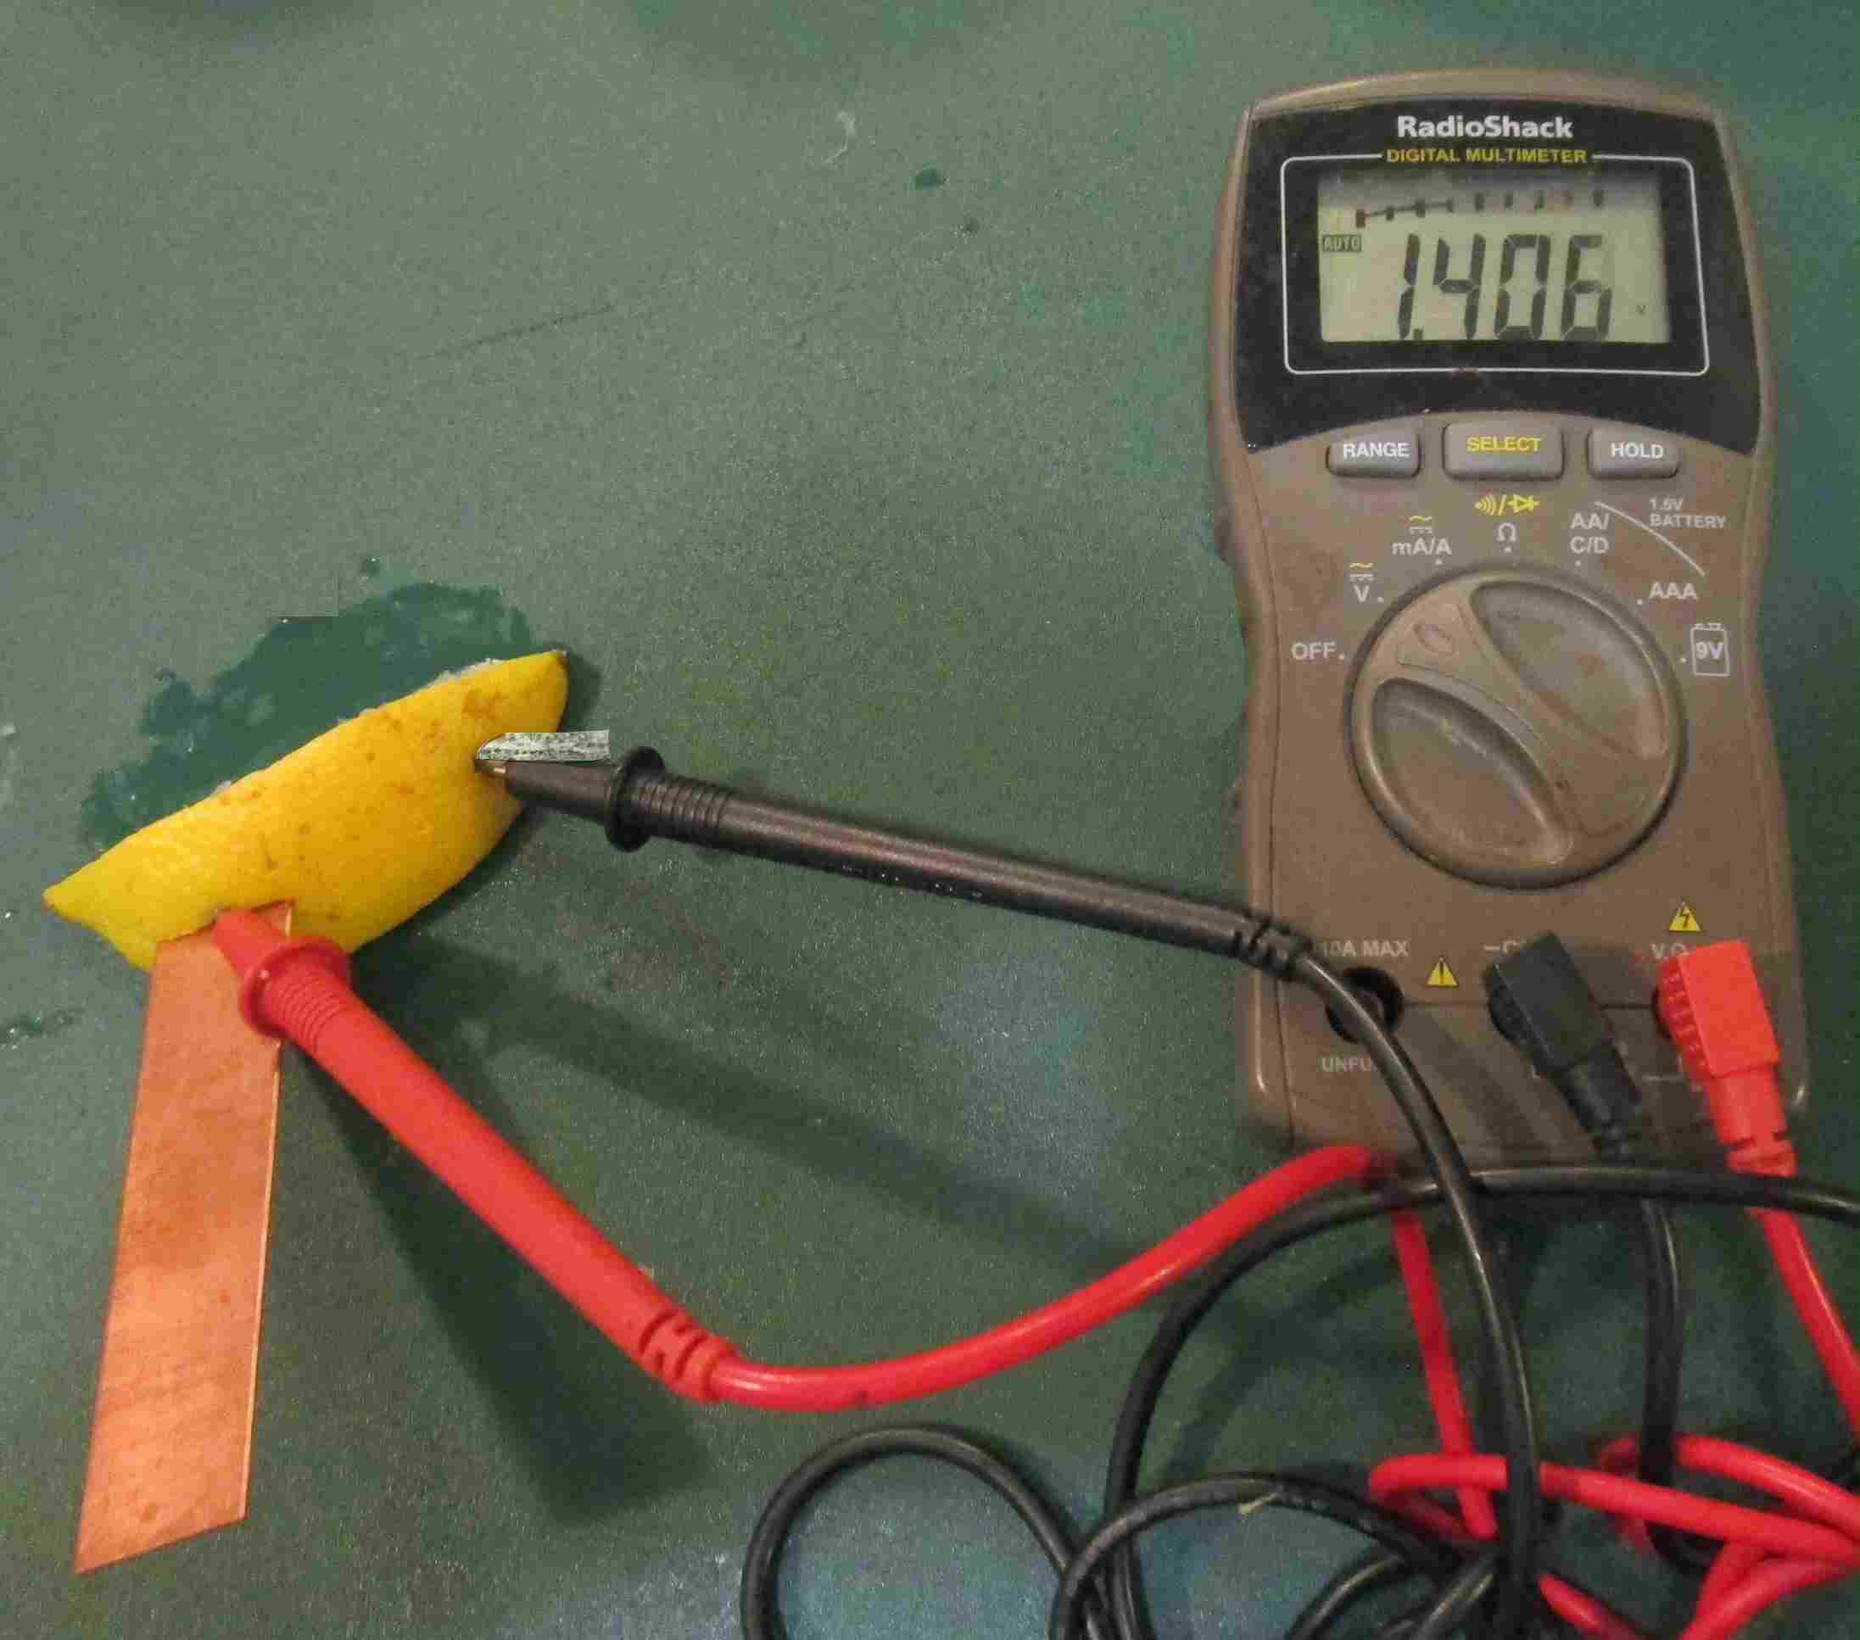
What happens to voltage when you put metals other than zinc and copper into the lemon?
aluminum foil & copper
magnesium strip & copper

Slide 14
Does the lemon generate the electricity?
No! The electric current flows when the zinc corrodes
and passes its electrons to the copper
(e-)
(e-)
(e-)
(e-)
If you run the battery using galvanized nails for too long
the zinc coating will wear off and your voltage will go down

