Slide 1
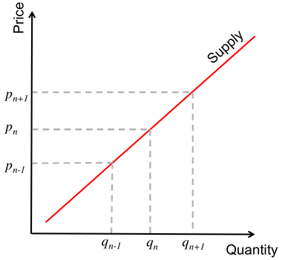
The more consumers are willing to pay, the more product a supplier would be willing to provide.
https://brilliant.org/wiki/supply-and-demand/

Slide 2
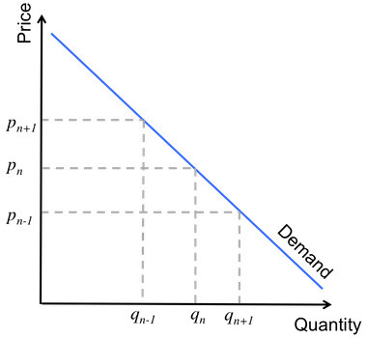
There is an inverse relationship between price and demand: as price increases, demand decreases.
https://brilliant.org/wiki/supply-and-demand/

Slide 3
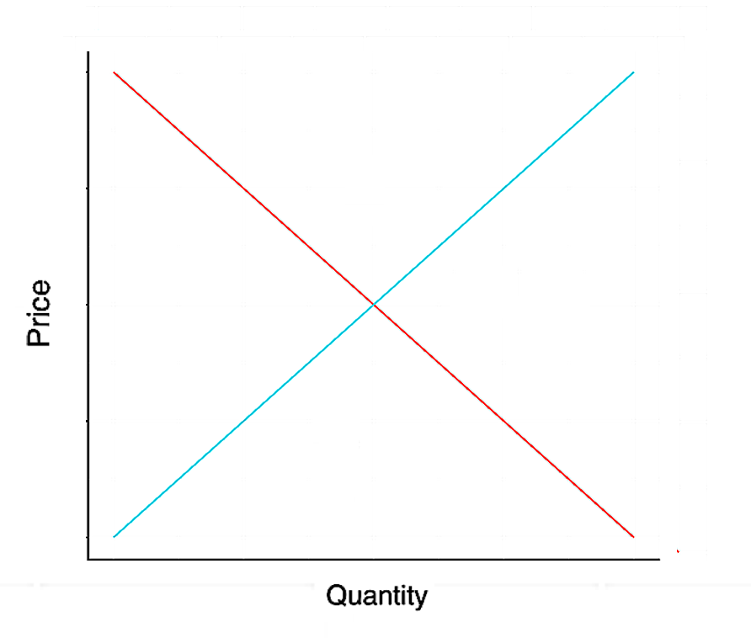
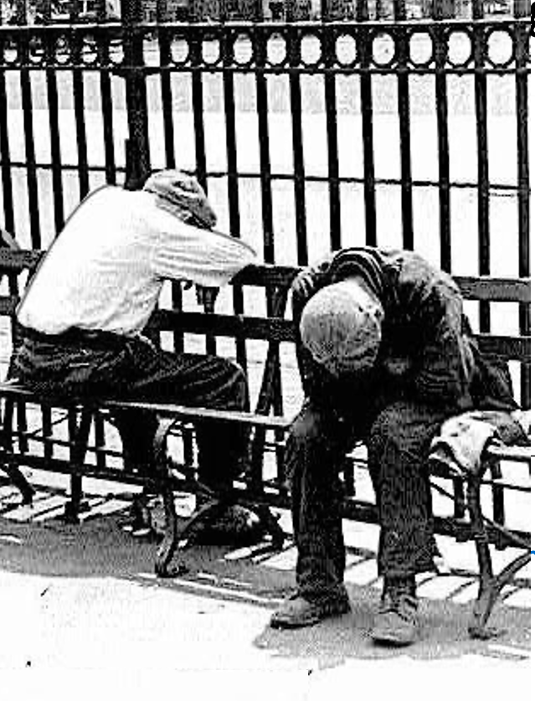
How do these trends work together?
Supply
surplus
shortage
Demand
If the price is too high, the supply will exceed the demand
If the price is too low, the supply will fall short of the demand
The market price occurs at the intersection of the two lines

