Slide 1
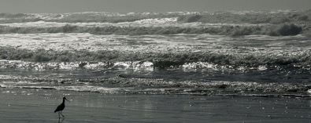
Causes of climate:

Slide 2
Greenhouse gases:
water vapor (H₂O)
carbon dioxide (CO₂)
methane(CH₄)

Slide 3
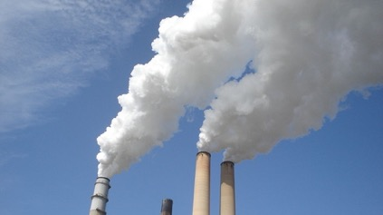
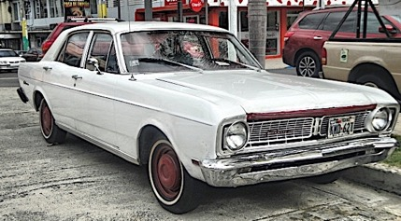
Sources of anthropogenic carbon dioxide:

Slide 4
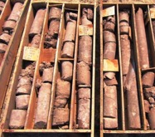
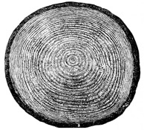
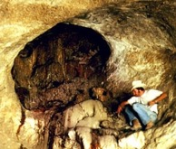
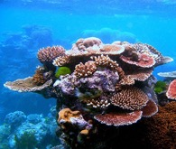
Sediment core, tree ring, packrat middens, and coral reef proxy measurements:

Slide 5
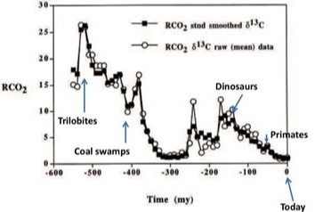
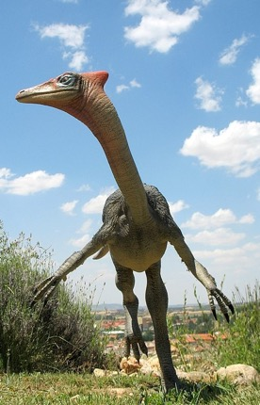
Nevertheless, some proxy measurements also indicate that CO2 levels may have far exceeded those of today during the time of the dinosaurs.

Slide 6
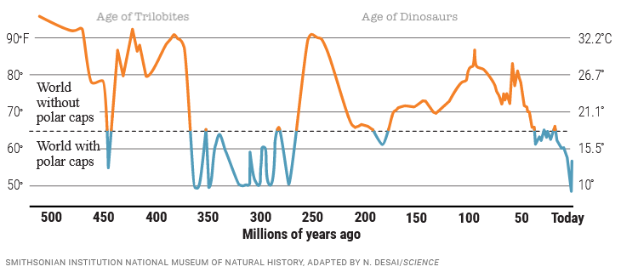
…and for most of geological history, the Earth was ice-free…
https://www.science.org/content/article/500-million-year-survey-earths-climate-reveals-dire-warning-humanity

Slide 7
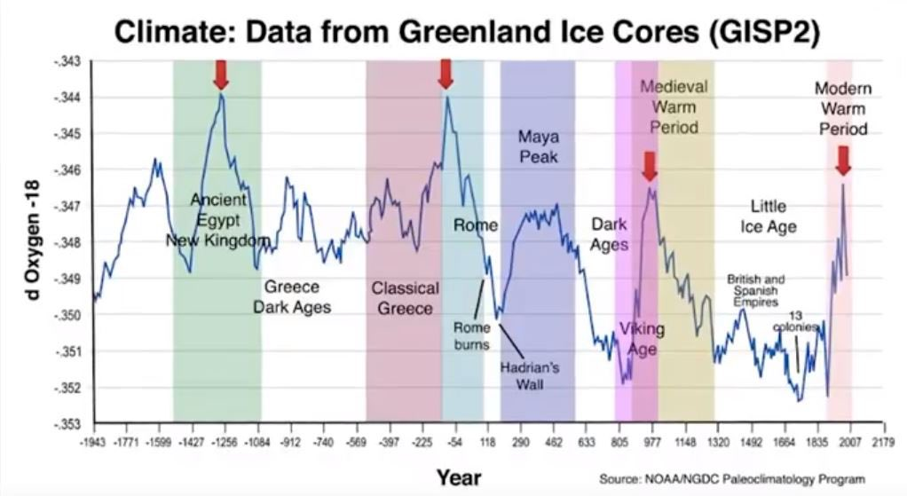
…and some proxy measurements indicate the Earth was warmer during these pre-industrial portions of human history.

Slide 8
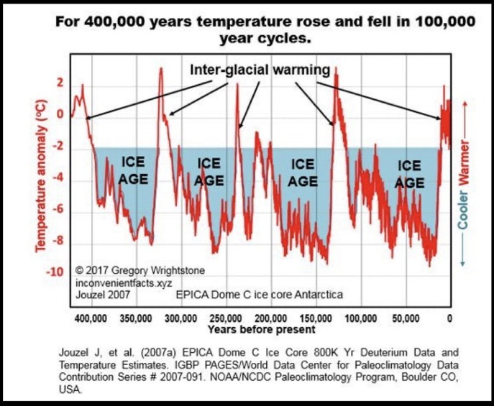
This might be attributed to cycling that is totally unrelated to human activity.

Slide 9
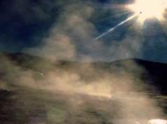
Climate predictions are further confounded by the dual role of water vapor.

Slide 10
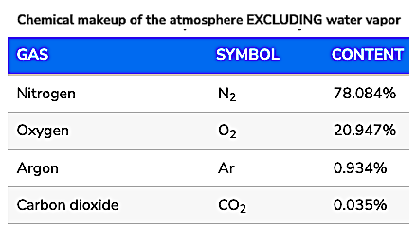
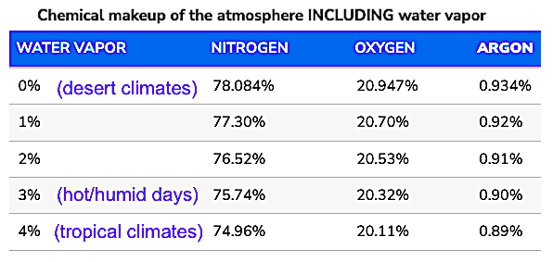
…and the overall percent of water vapor in the atmosphere far exceeds that of carbon dioxide:
https://www.noaa.gov/jetstream/atmosphere

Slide 11
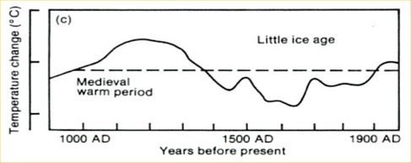
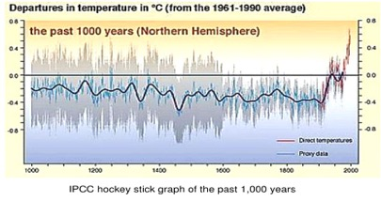
The graph in your book is from the 2001 IPCC Report.
It is very different from the report published in 1990.
1990 IPCC Report
2001 IPCC Report
The 1990 graph is reportedly based on a wide range of proxy data.
The 2001 graph reportedly grafted a narrower range of proxy data
…to selected temperature records from the 20th century.
This combination of sources differing in methodology forms the basis of the “hockey stick graph” controversy.
https://www.theunion.com/opinion/norm-sauer-mann-s-hockey-stick-a-documented-hoax/article_5e9bee14-1468-59aa-90d9-6d1e82f584cf.html

Slide 12
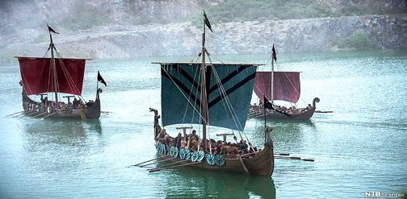
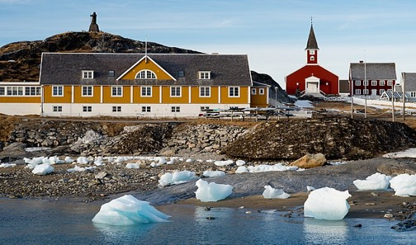
During the Middle Ages, Vikings cultivated these crops
…in Greenland.
Barley
Rye
Oats
Cabbages
Onions
Garlic
Leeks
Turnips
Beans
Peas
Downloaded from: https://www.historyonthenet.com/life-on-a-viking-farm

Slide 13
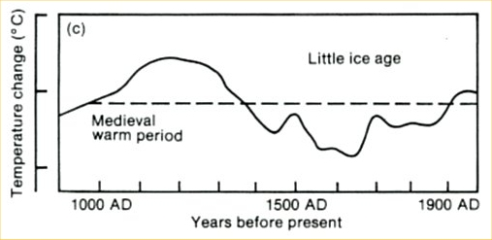
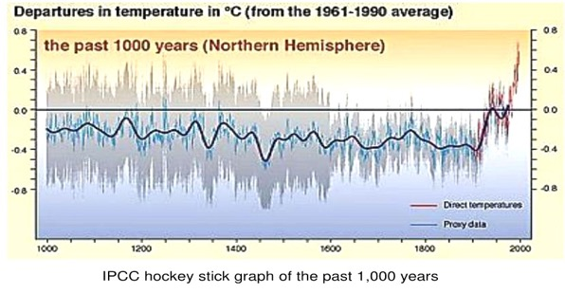
The settlement in Greenland lasted from 985-1450 AD.
Downloaded from: https://www.history.com/news/why-did-the-viking-disappear-from-greenland

Slide 14
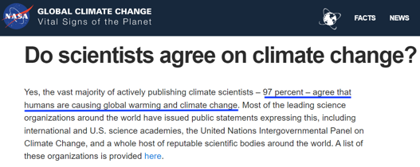

Slide 15
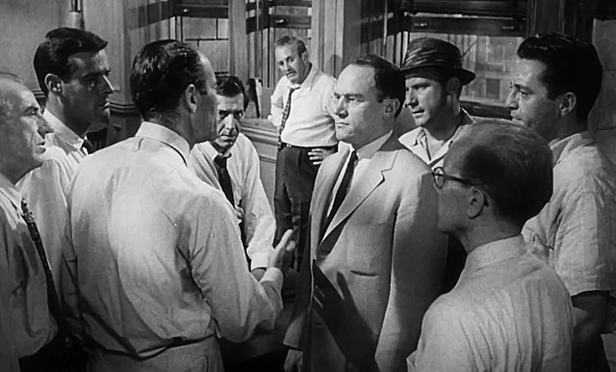
“Historically, the claim of consensus has been the first refuge of scoundrels; it is a way to avoid debate by claiming that the matter is already settled.” ― Michael Crichton
Scene from the 1957 movie “12 Angry Men”

Slide 16
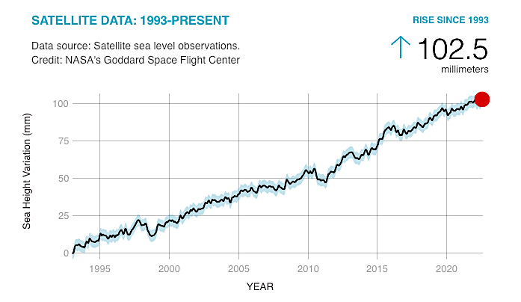
Can we estimate how fast sea levels are rising?
This graph covers 30 years. How many mm per year?
How many total mm by 2100? (77 years)
If 1 inch = 25.4 mm, how many total inches by 2100?
Is this estimate reliable? What did you need to assume?
https://climate.nasa.gov/vital-signs/sea-level/

Slide 17
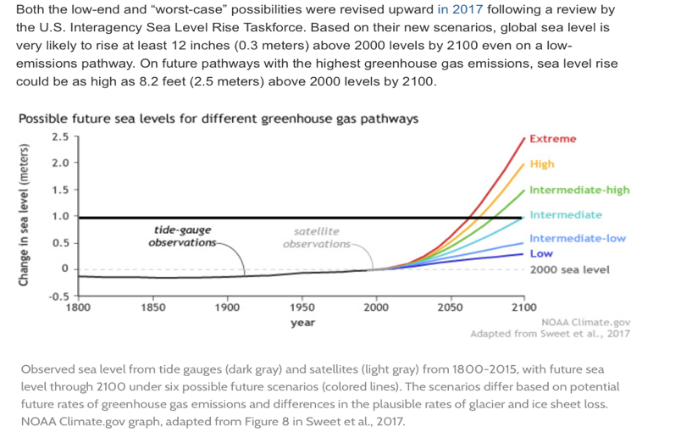
NOAA projects sea level increases that vary from a few inches to about 7 feet by 2100.
How does this square with your calculation?

Slide 18
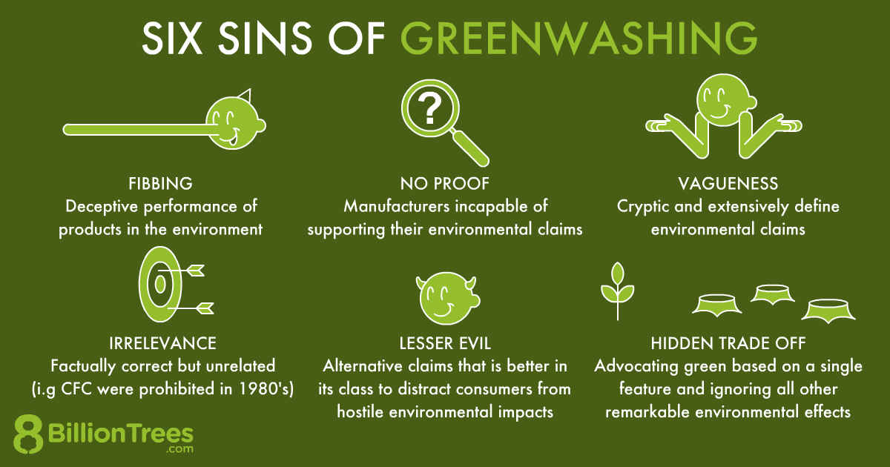
Unfortunately, carbon trading is riddled with fraud!
Greenwashing is when a company uses deception to appear “green” while engaging in business as usual.
Images downloaded from: https:///best-programs-providers8billiontrees.com/carbon-offsets-credits-companies-2021/neutral-certification-companies/

Slide 19
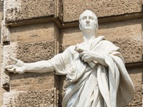
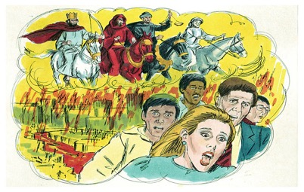
Cui bono?
Who benefits from climate change denial?
Who benefits from climate change alarmism?

Slide 20
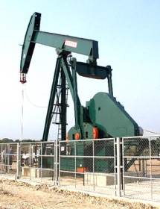
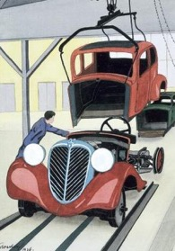
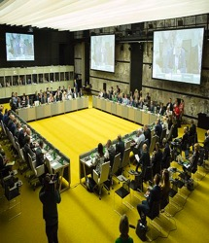
Cui bono?
Who benefits from climate change denial?
The fossil fuel industry and car manufacturers.
Who benefits from climate change alarmism?
International organizations, unelected bureaucrats and “green” corporations.

