Slide 1
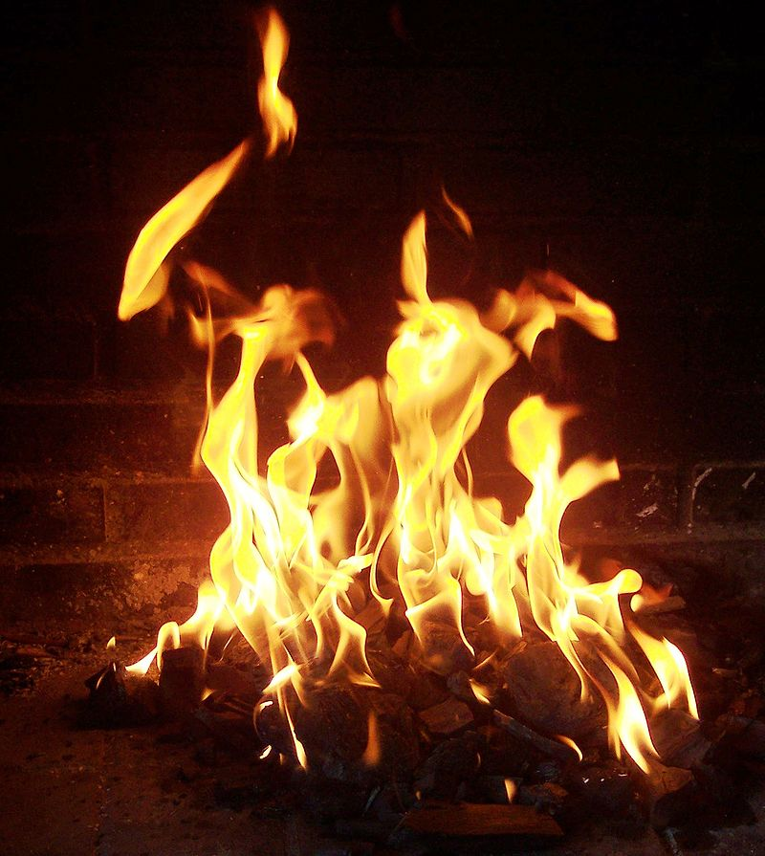
Combustion
→
sugar + oxygen carbon dioxide + water
100 g 108 g 148 g 60 g
400 Cal. 0 Cal. 0 Cal.
→
→
→
Produces about
400 Cal. heat & light

Slide 2
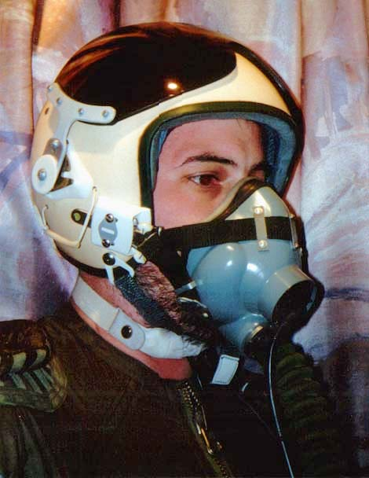
Respiration
sugar + oxygen carbon dioxide + water
100 g 108 g 148 g 60 g
400 Cal. 0 Cal. 0 Cal.
→
→
→
→
Produces about
160 Cal. of cellular energy

Slide 3
Review Questions
What is the purpose of cellular respiration?
What process provides the energy needed for cellular respiration?
What process synthesizes sugar from carbon dioxide and water?
What provides energy for the synthesis of sugar?
Why does the consumption of 400 calories of sugar only generate 160 calories of cellular energy?
Notes:
Answer: a

Slide 4
Review Questions
What is the purpose of cellular respiration? It generates energy for our cells.
What process provides the energy needed for cellular respiration? the oxidation of sugar
What process synthesizes sugar from carbon dioxide and water? photosynthesis
What provides energy for the synthesis of sugar? sunlight
Why does the consumption of 400 calories of sugar only generate 160 calories of cellular energy? The second law of thermodynamics.
Notes:
Answer: a

