Slide 1
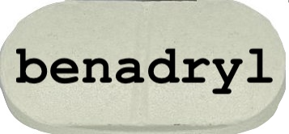
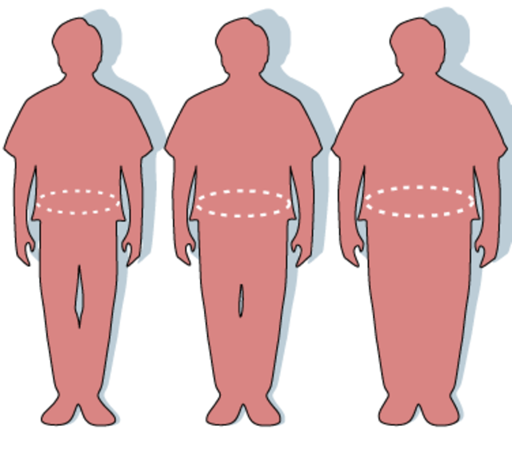
Experiment for Testing a Hypothesis
Independent variable: the probable cause (x-axis)
Dependent variable: the probably effect (y-axis)
Negative control: produces a (-) result when a (-) result is expected
Positive control: produces a (+) result when a (+) result is expected
Experimental group: group subjected to the novel treatment
Confounding variables: variables not under observation that can affect the data

Slide 2
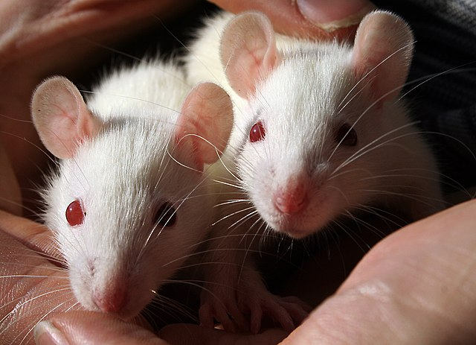
Manipulative experiments
Natural experiments

Slide 3
Peer review

Slide 4
paradigm shifts

